Slide 1
RIGID HEDDLE STUDY GROUP
OCTOBER 26, 2021

Slide 2
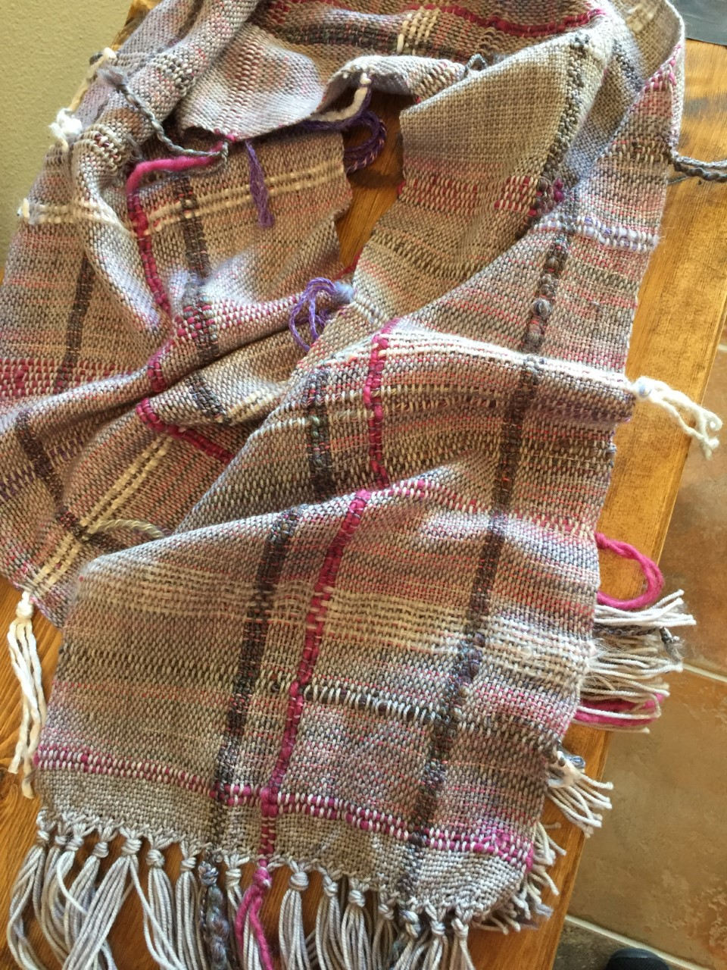
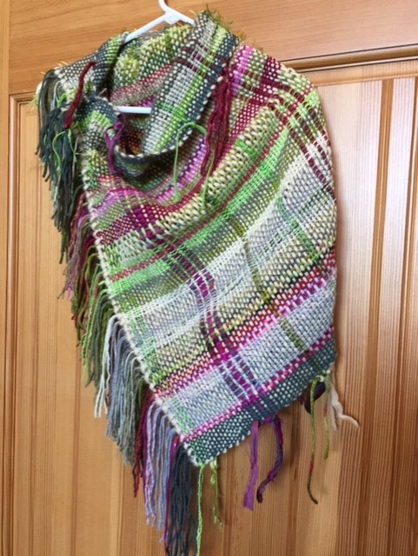
Sharyl McCulloch: Pieces woven using Vari-dent heddle. Random plaids coinciding with October lesson plan.

Slide 3
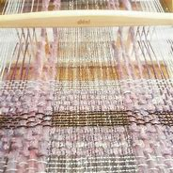
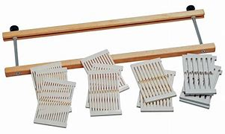
Sharyl McCulloch: Vari-dent heddle – “unloaded” and in use with various weights/widths of yarn on a RHL.

Slide 4
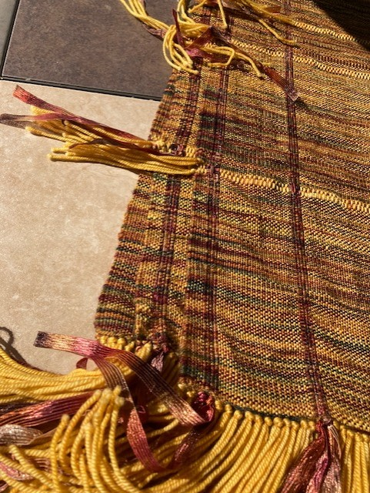
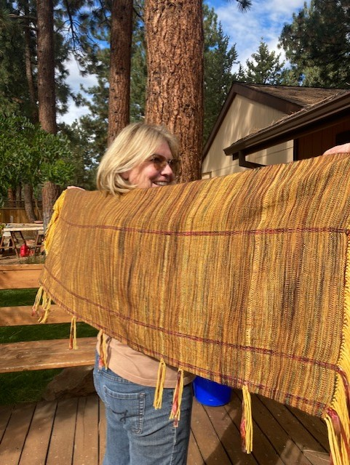
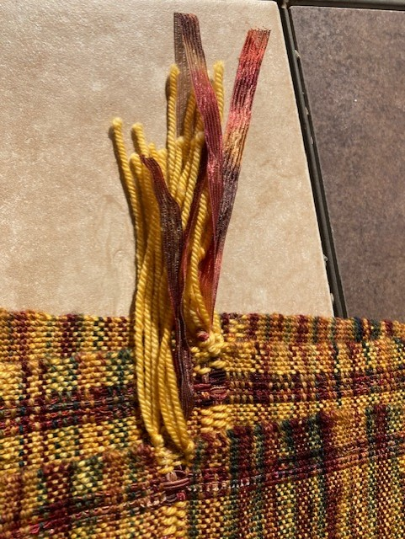
Marsha Phelps: First shawl using Lion Brand ribbon yarn for warp and weft. 12 dpi

Slide 5
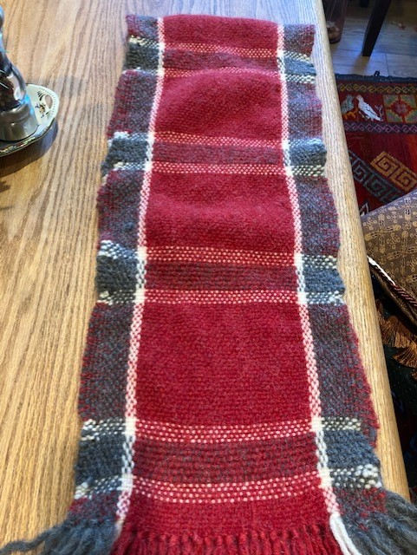
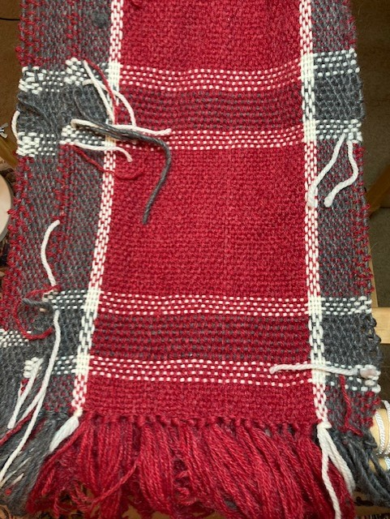
Marsha Phelps: Weaving pattern on pg 132 to be fulled or felted…..
Just off the loom; knotting warp
After gently felting in bathtub and drying in the dryer. Will repeat process to get thicker; agitating more in tub, then dry….

Slide 6
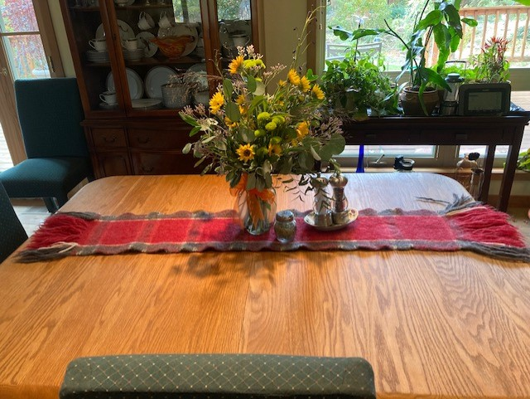
(plaid weaving cont’d): Bulky Lamb’s Pride wool, natural color Imperial Yarn Company and a red yarn from Sharyl 8 dpi

Slide 7
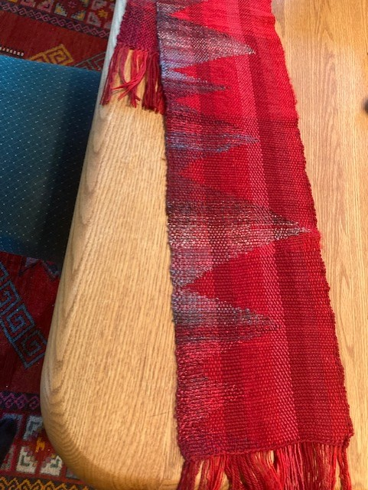
Marsha Phelps: Latest project!

Slide 8
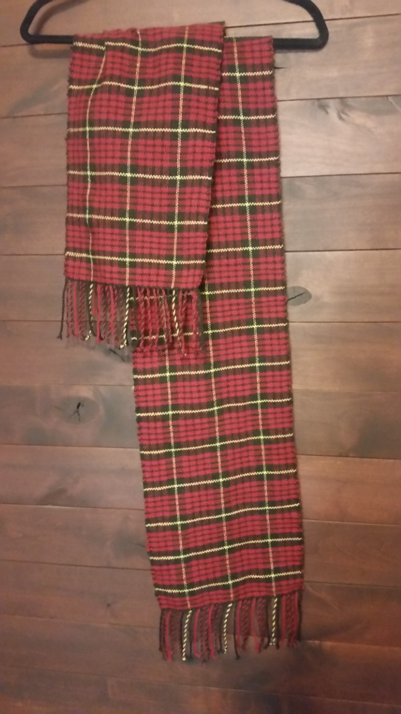
Randee Frommer: Tartan scarf for my husband. Knit Picks wool fingering yarn 12 dpi

Slide 9
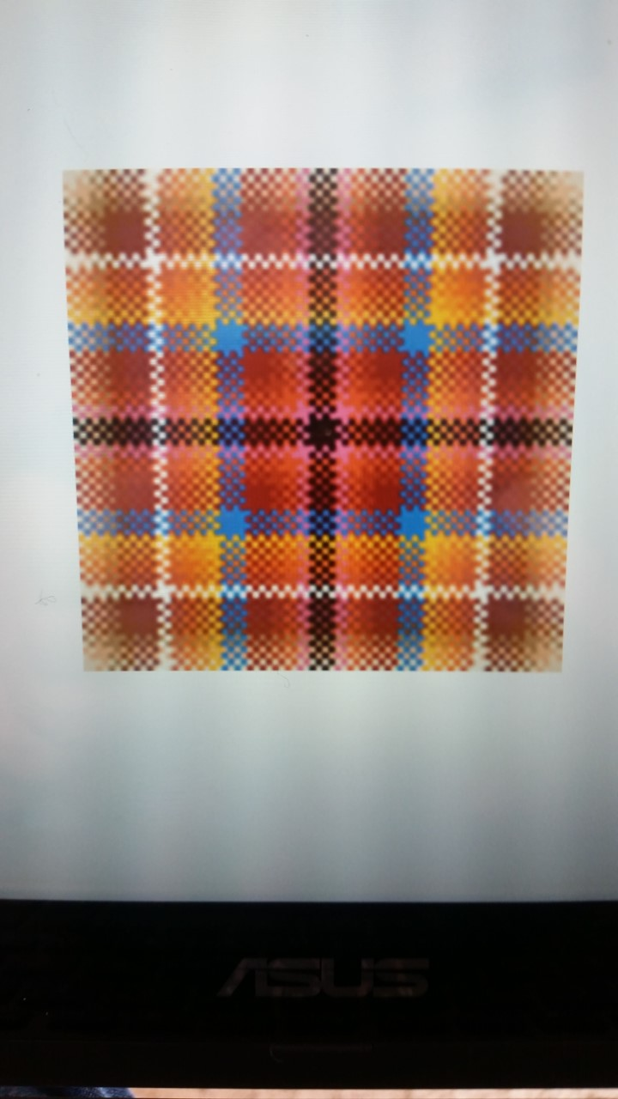
Randee Frommer: Study using Plaid Works App

Slide 10
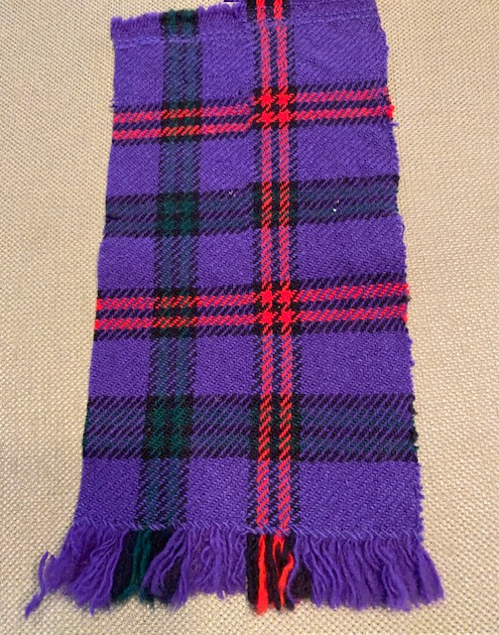
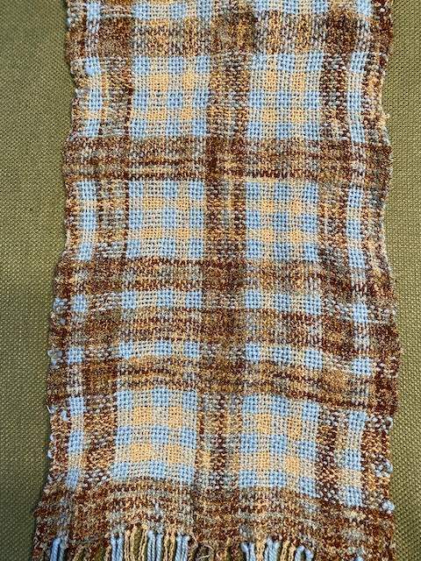
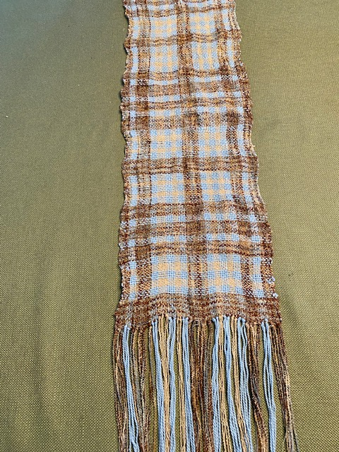
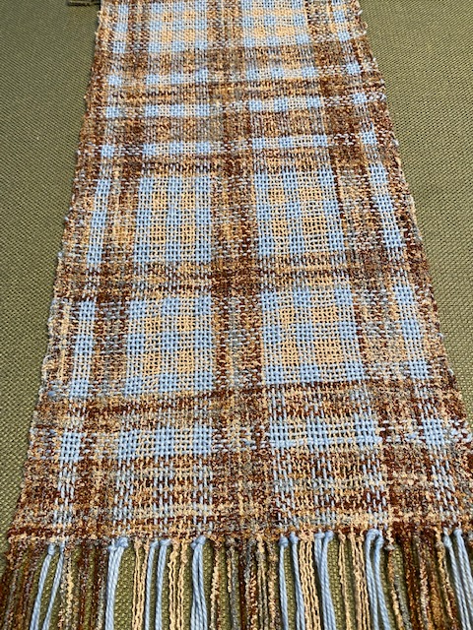
Mary Anna Swinnerton: Plaids
This was the warp Randee and I used for the video to demo how to use warp from a warping board on a rigid heddle loom.
The brown thread was 3-ply with one nylon and 2 cotton and so, when washed, there was differential shrinkage. This gave interesting texture to the scarf.
Doing a woven sample first to wash and dry the yarns is always a good idea.

Slide 11
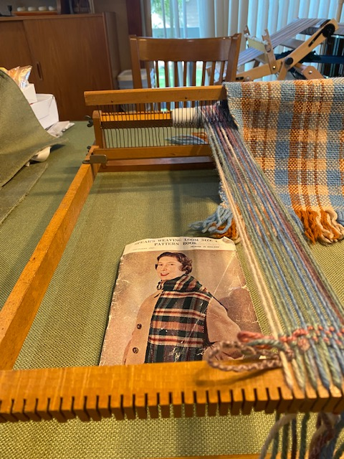
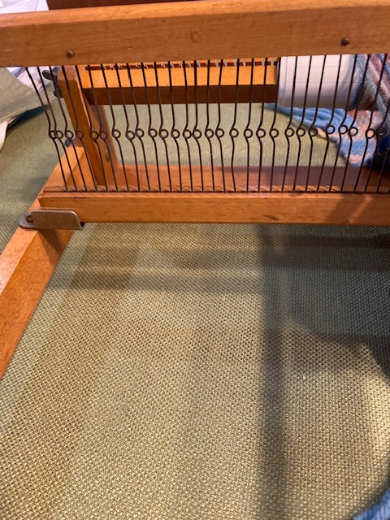
Mary Anna Swinnerton: My mother’s Montgomery Clan Plaid (Sample from Linda Davis Tartan Workshop several years ago) creating a plaid by letting the number and order of warp threads determine the number and order of weft shots a “Warp Determined Plaid”
1966 -My first Rigid Heddle Loom –
Spears brand from England – Notched
slots on front cloth and back warp beams
(2 warps/slot – 5 dpi or 10 threads/inch)
The holes were made by a looped wire with
Space between for the slot. On either side
A “rest” for the heddle kept it in neutral position.
Weaving was done by raising and lowering the heddle and pulling it forward to beat.
Threading was done with a crochet hook or
Dental Threading Floss

Slide 12
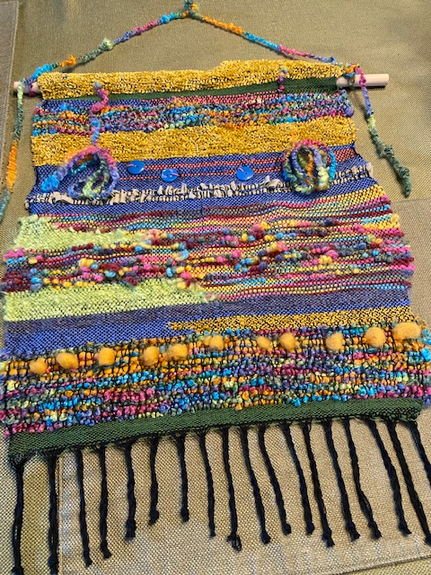
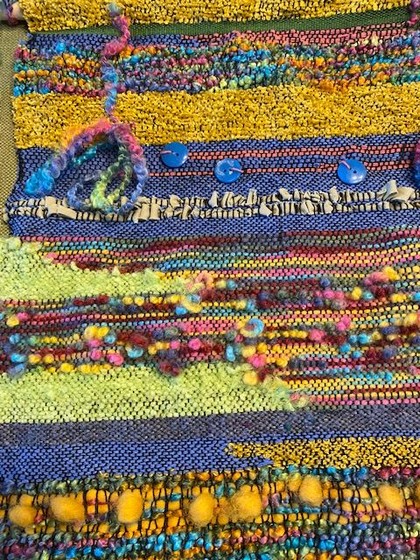
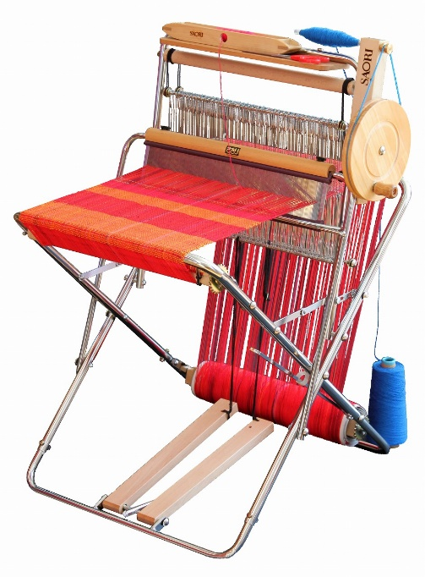
Mary Anna Swinnerton:
SAORI FREE FORM WEAVING – 2017 – ANWG CONFERENCE, VICTORIA, B.C.
SAORI Weaving is a contemporary hand weaving method founded by Misao Jo (1913-2018, Japan) in 1969. She named her weaving style 'SAORI' in which anyone can express oneself freely regardless of age, gender, disability or intellectual aptitude. In SAORI, people can enjoy hand weaving as an art form, not only as a hand craft.
It's a plain weave, experimental, free-style approach to weaving pioneered in Japan. (The Saori website has all the history.) Saori emphasizes finger manipulation techniques, color, texture and self-expression
The Saori Loom

Slide 13
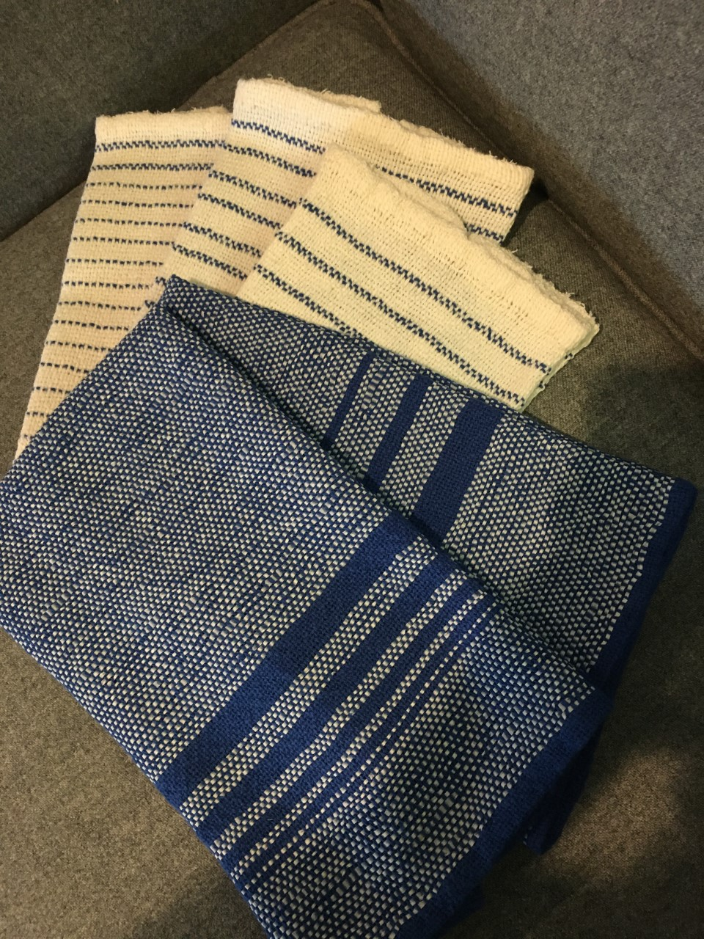
KAY PARKINSON: Towels 2 New towels; weft is linen paper and warp is blue 8/2 cotton The white towels are the original towels presented at the last meeting.

Slide 14
END OF PRESENTATION!

