Slide 1
RIDGID HEDDLE STUDY GROUP
PRESENTATION OF OUR
“weave to wear challenge”
JULY 19, 2023
COSW MEETING

Slide 2
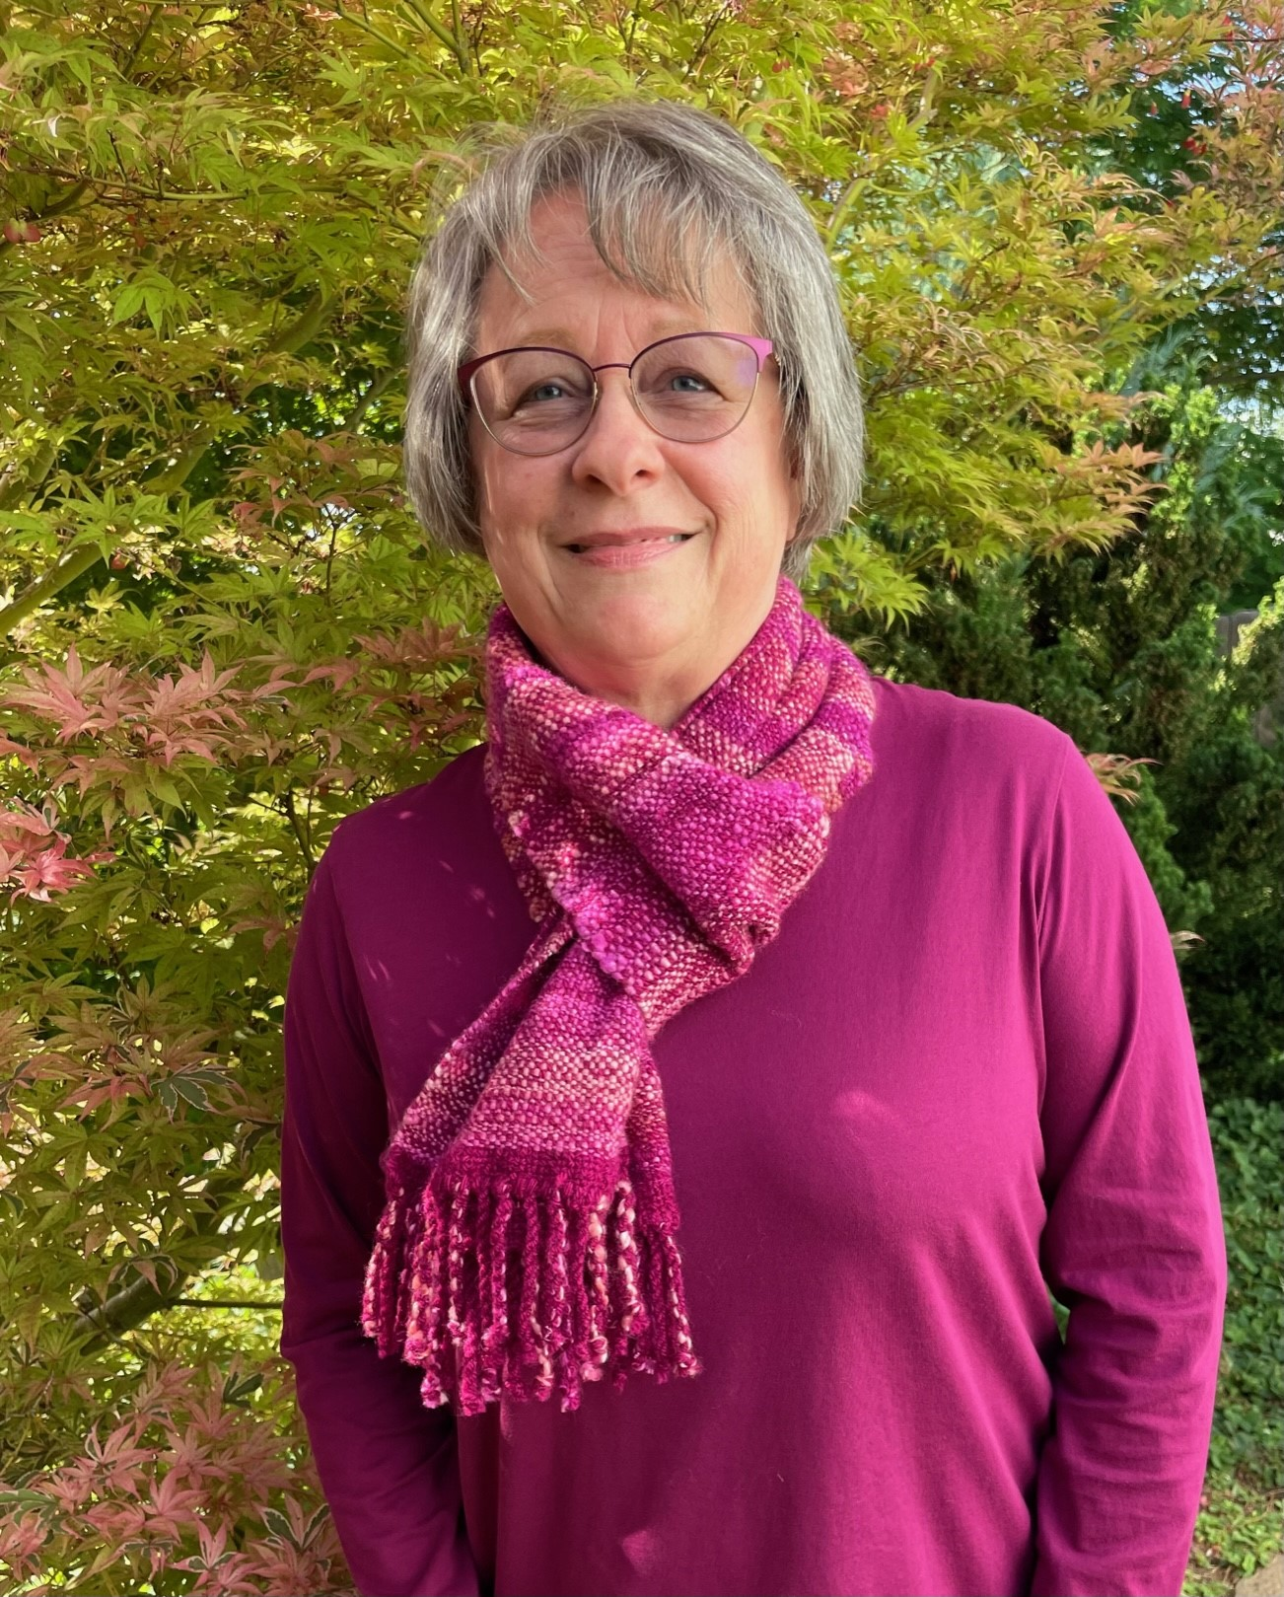
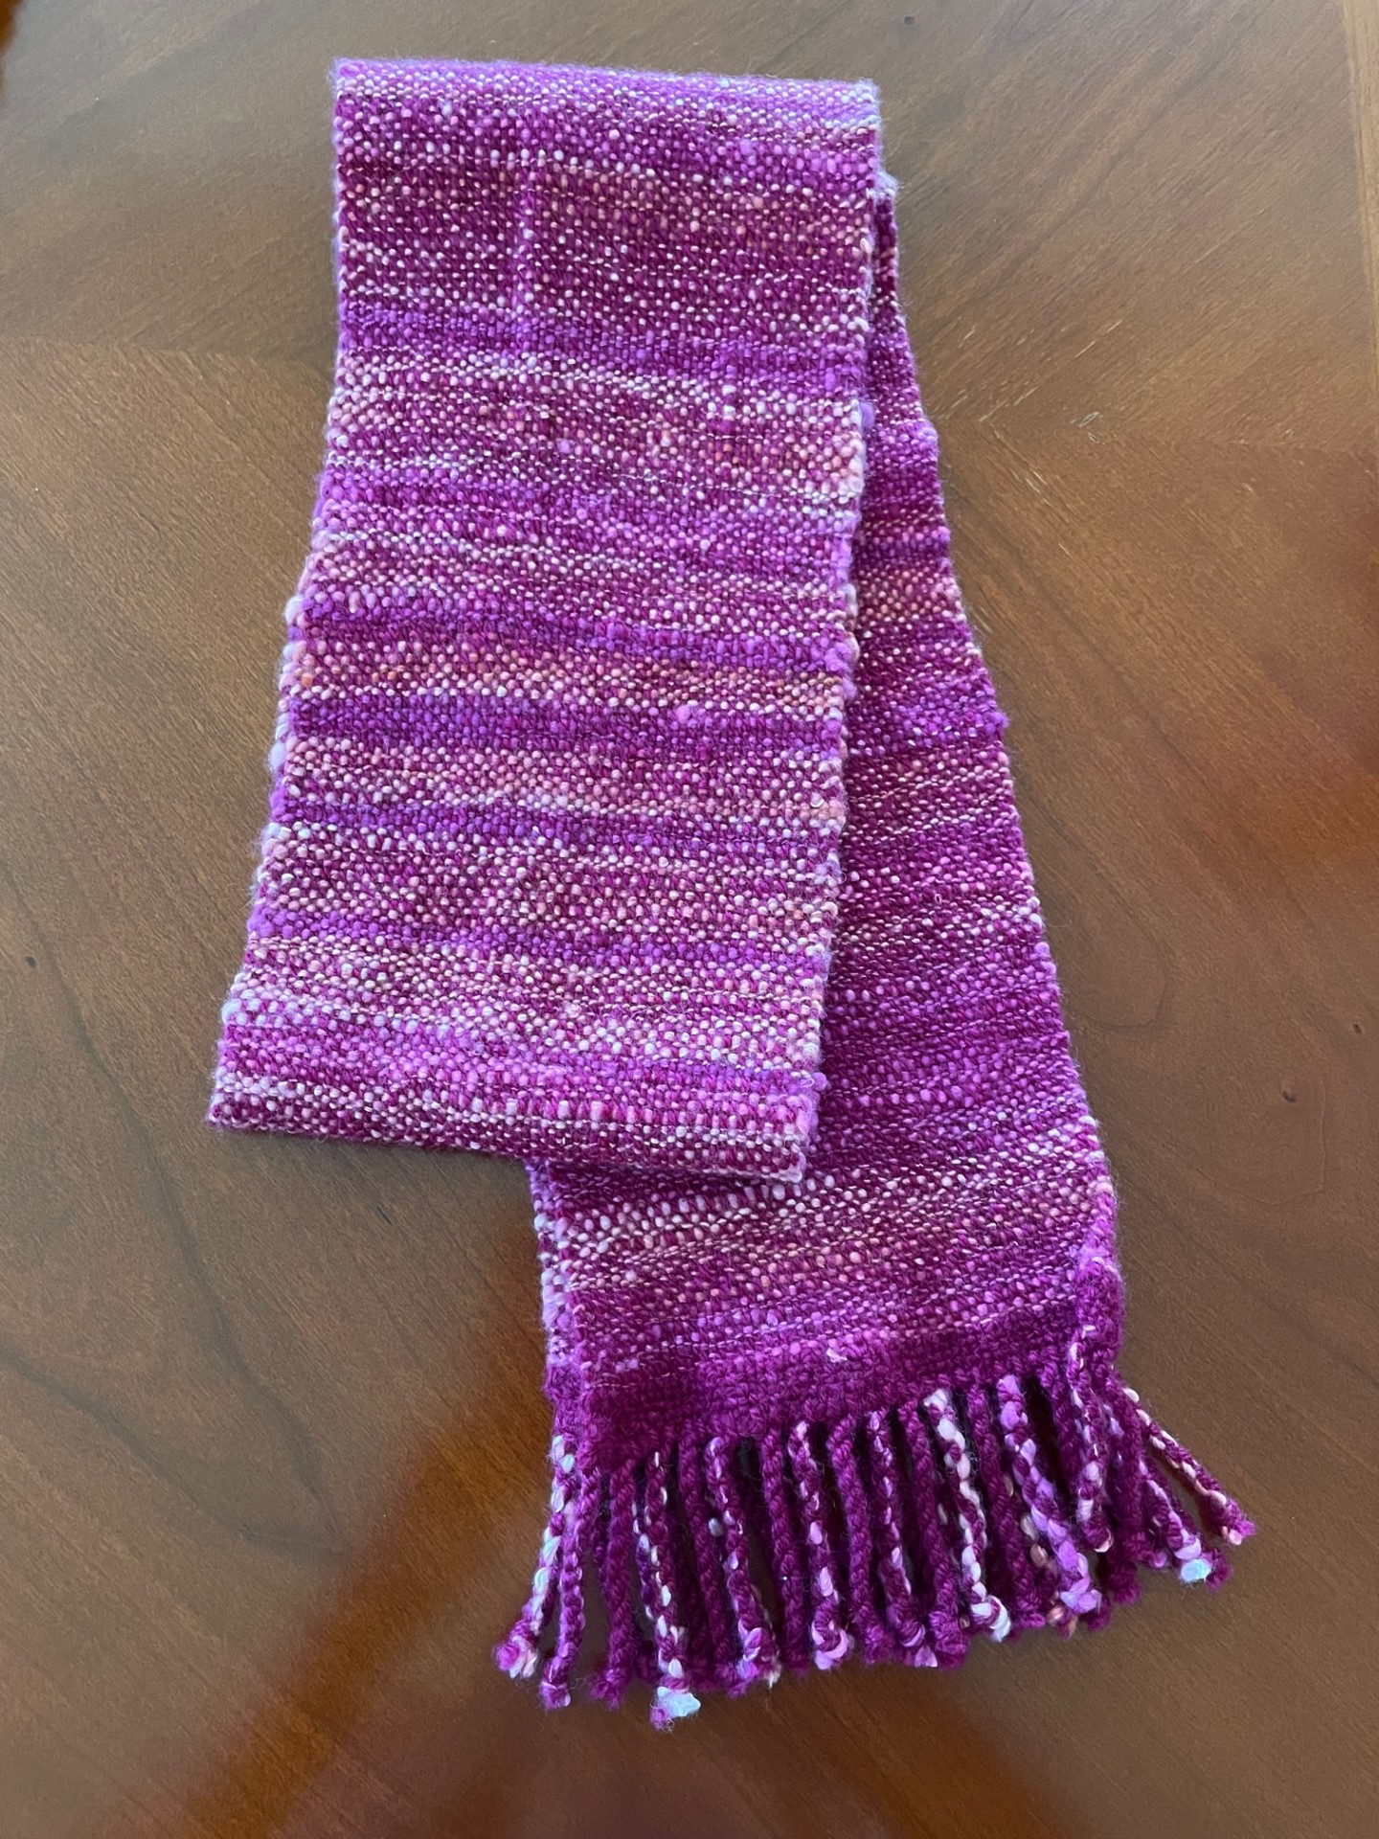
CAROL MAY: SCARF
Finished size 7.5 x 72 inches
8-dent heddle, plain weave
Warp: commercial worsted weight knitting yarn
Weft: my first drop spindle handspun wool
I like the thick and thin rustic look of my first attempt at hand spinning. (first drop spindle spun yarn!)

Slide 3
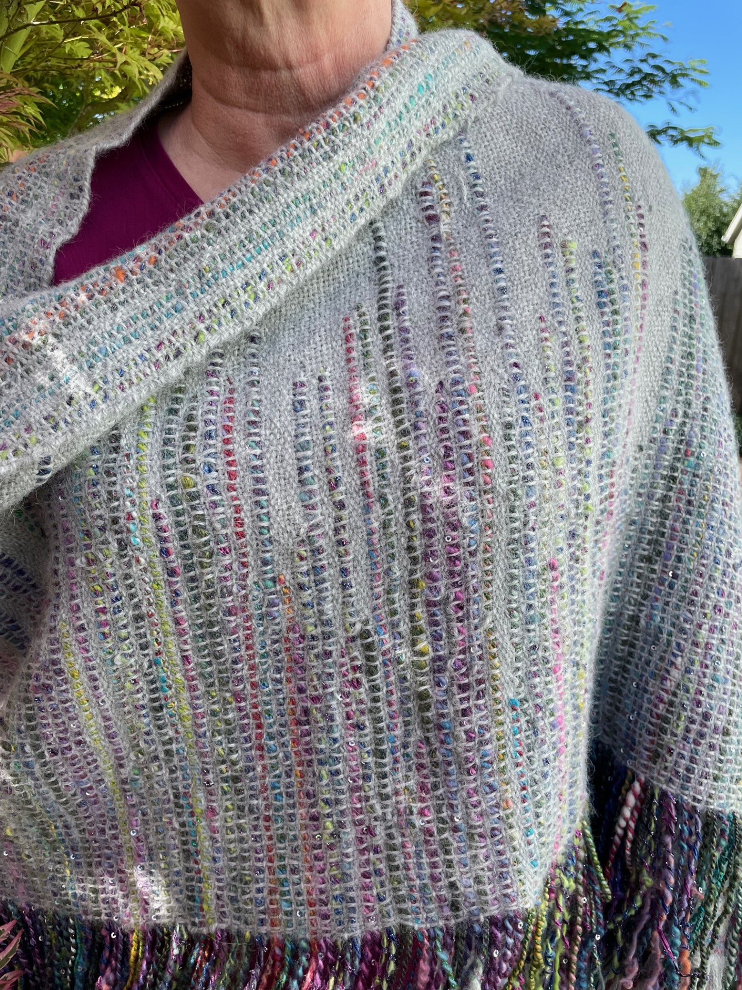
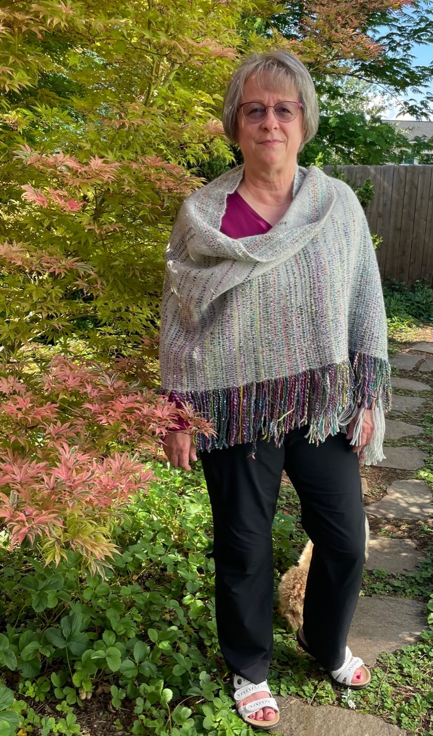
Carol may: shawl with art yarn weft inlay
Warp: DK baby alpaca knitting yarn
Weft: Dk baby alpaca
Inlay: art yarn of mixed materials purchased at an estate sale
10 dent heddle
Shawl was inspired by a photo on Pinterest. Explanation of the inlay process came from Inventive Weaving on a Little Loom by Syne Mitchell and The Weaver's Idea Book by Jane Patrick.
Learnings: Since the art yarn was thicker than the other weft, I had to use some tapestry techniques (example: meet and separate to compensate). Ideally, the inlay yarn would be a closer match in thickness to the main weft yarn.

Slide 4
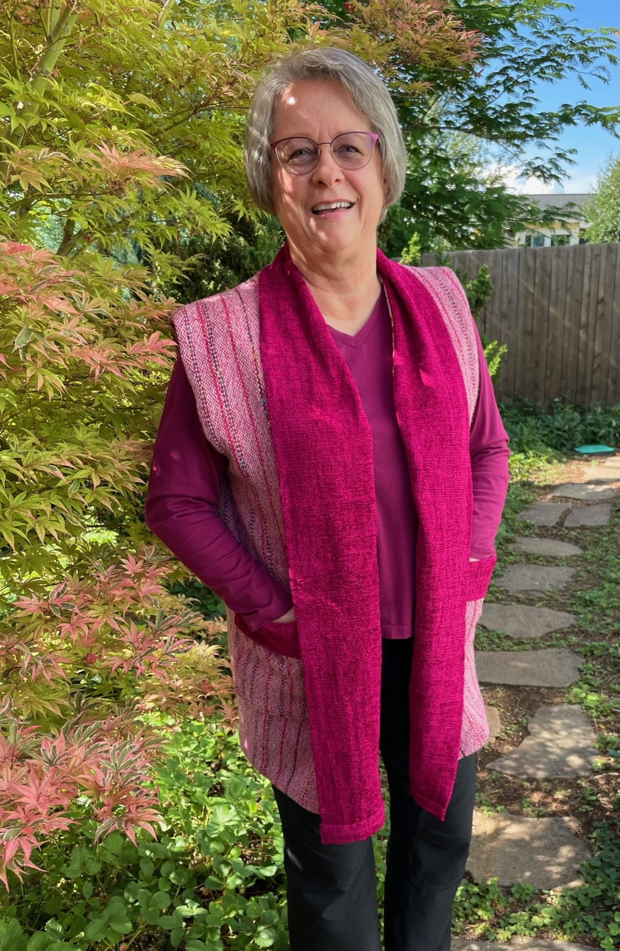
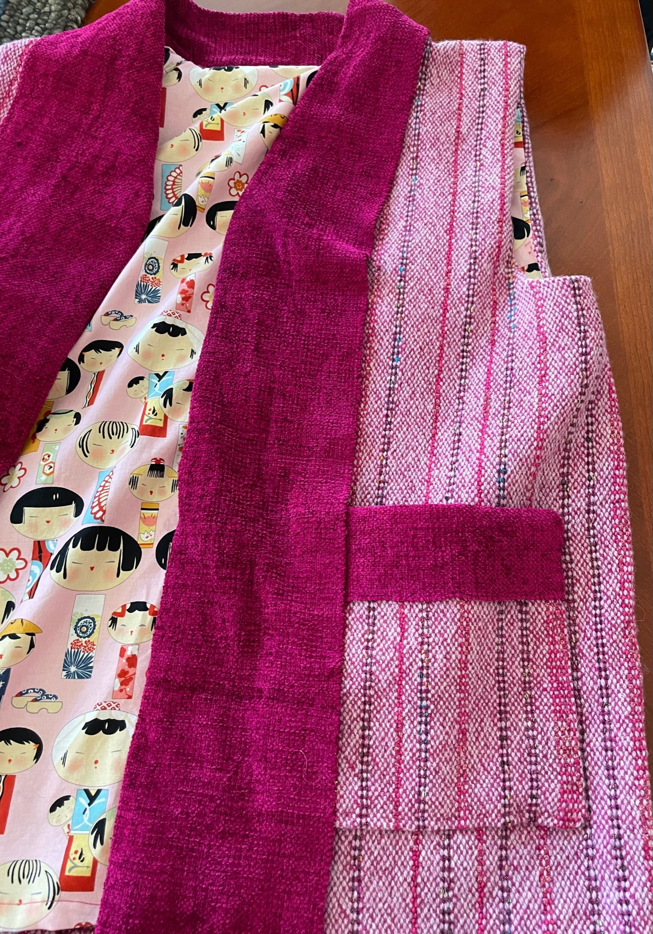
Carol may: VEST
TRIM:
Warp: 5/2 cotton
Weft: Chenille
Main Fabric:
Warp: DK wool weaving yarn with stripes of novelty yarn
Weft: DK wool weaving yarn
10 dent heddle
Pattern:
I copied a vest that I have for the basic body, then I added length, a shawl collar, pockets, and lining.
Before I started weaving the main fabric, I made a sample and wet finished it with some time in the dryer. I took note of the shrinkage. I planned accordingly, but the full-sized fabric shrank a lot more than predicted. Hence, the vest and not the kimono jacket I had originally envisioned. I learned to weave even more fabric to be prepared for surprises.
Thank goodness for ANWG conference class on sewing on handwoven fabric!

Slide 5
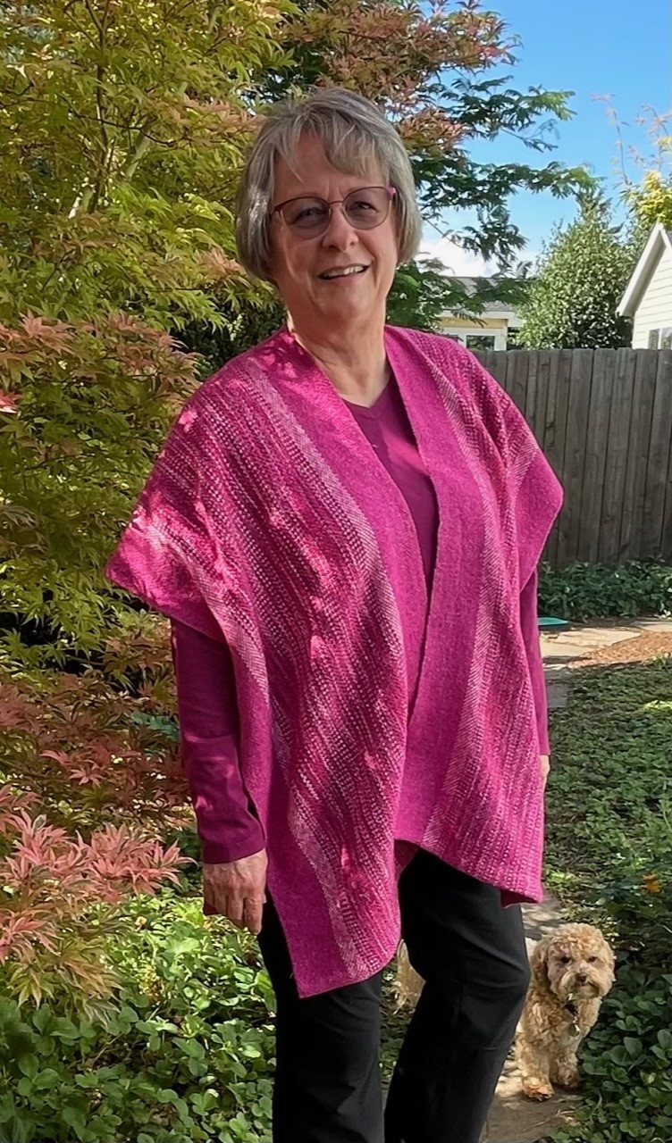
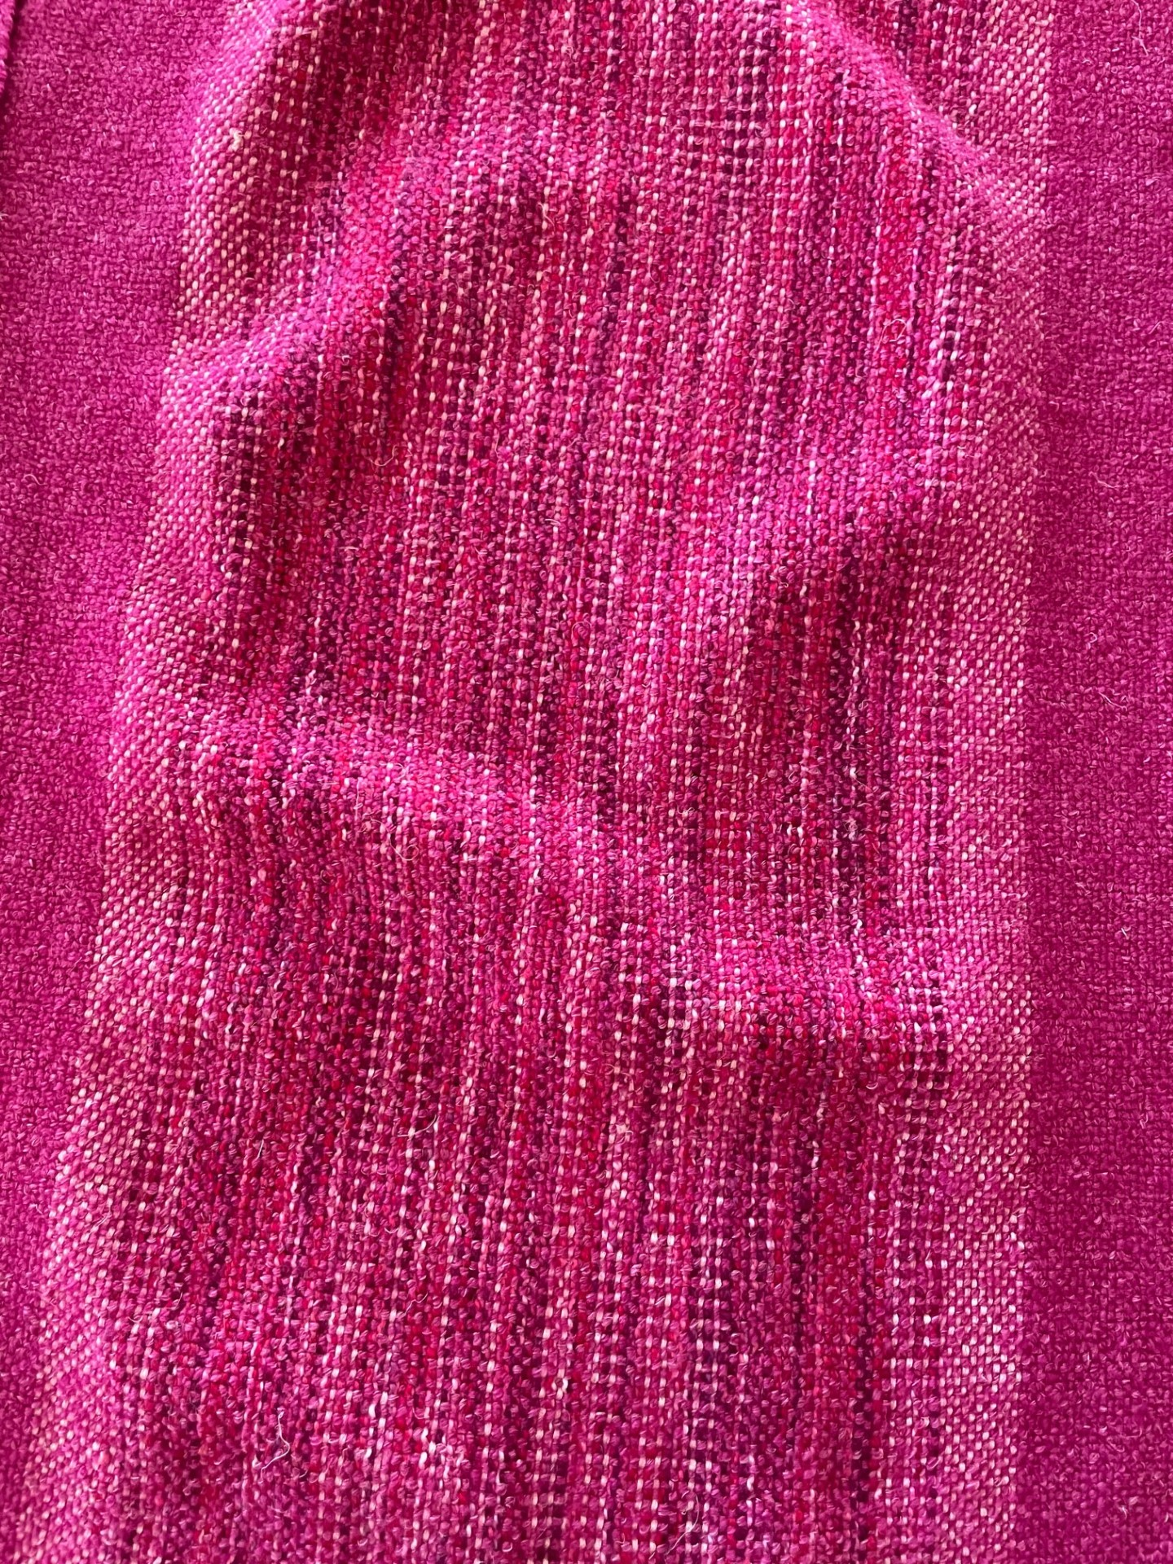
CAROL MAY: ruana
Warp: Wool/linen blend for the raspberry main color, bamboo weaving yarn (light pink), Ashford's Caterpillar Cotton in a variegated colorway
Weft: Wool/linen blend knitting yarn (raspberry)
12 dent heddle
Wet finished with some time in the dryer.
Woven in one long piece, cut in two and seamed up the back.
I learned that some unconventional fiber pairings may actually work well together.

Slide 6
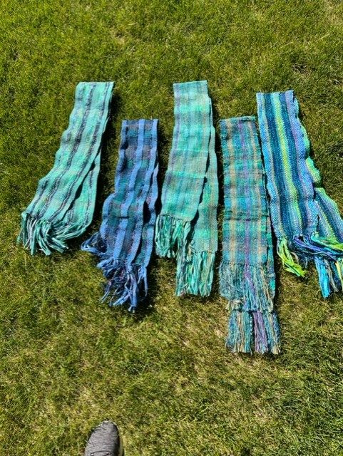
Marsha phelps: scarves for the bc 50th anniversary trip
All were woven with 10 dent in different combinations of Bernini ladder glitter, Lion acrylic/ cotton prism w/ glitter, Lion rewind tape yarn, unique multicoloured recycled nylon, recycled sari silk strips, with weft of Yarnlala In Tune DK.
There’s also some recycled paper yarn and acrylic ribbon yarn wrapped with long eyelash nylon.
I love how similar and different they all turned out!

Slide 7
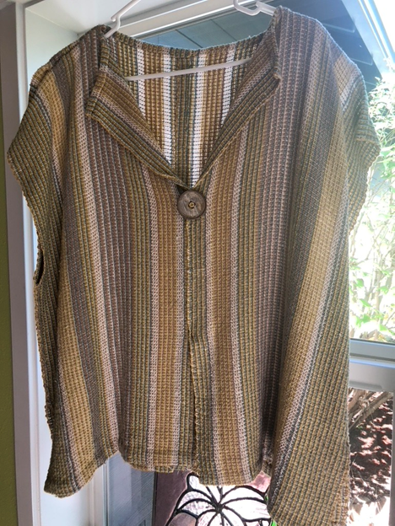
Sara Freitag: 2 Shirts
Tweety Shirt from Weave Knit Wear by Judith Shangold
Loom: Ashford
Dent: 12.5
Fiber: mixture of medium weight and fine: bamboo, cotton, silk, linen
Lessons Learned: don’t leave a warped loom for 4 years; hard to pick up where you left off!
Goals in weaving: learn pick up sticks

Slide 8
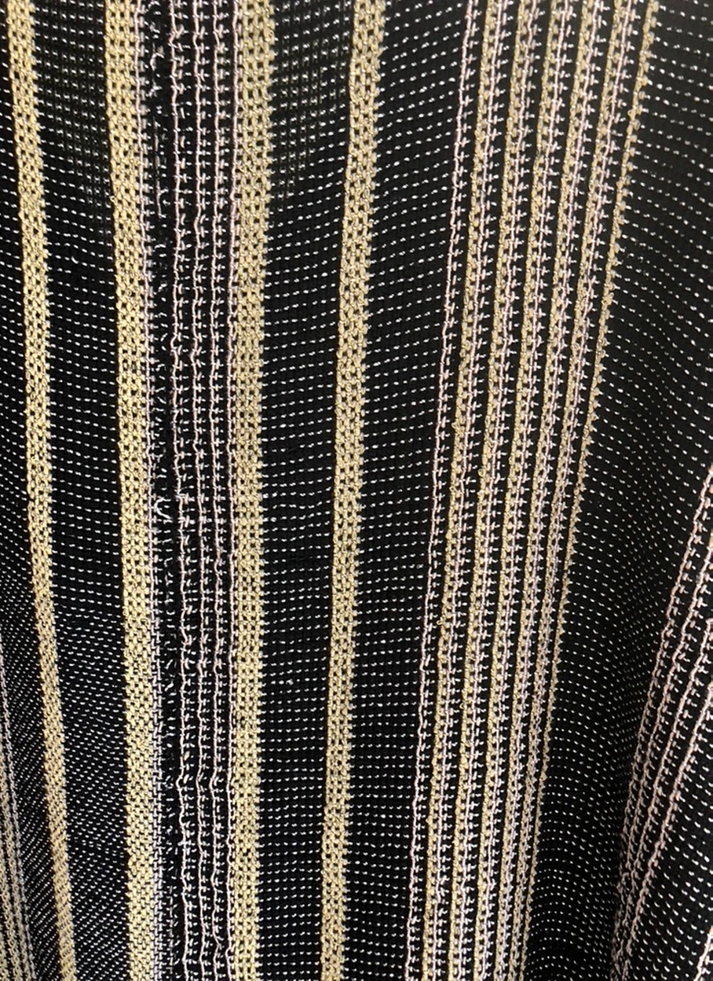
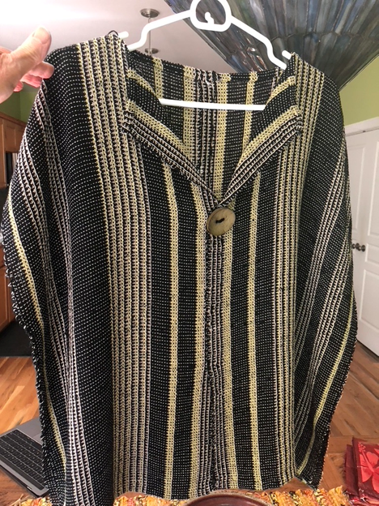
Sara Freitag: (ConT’d)

Slide 9
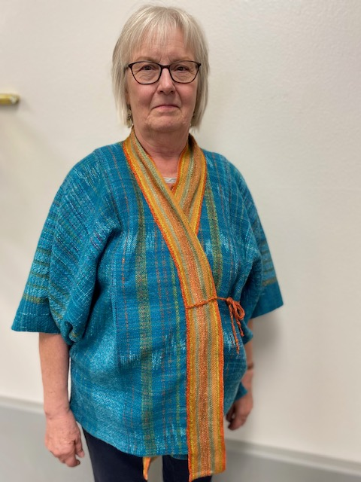
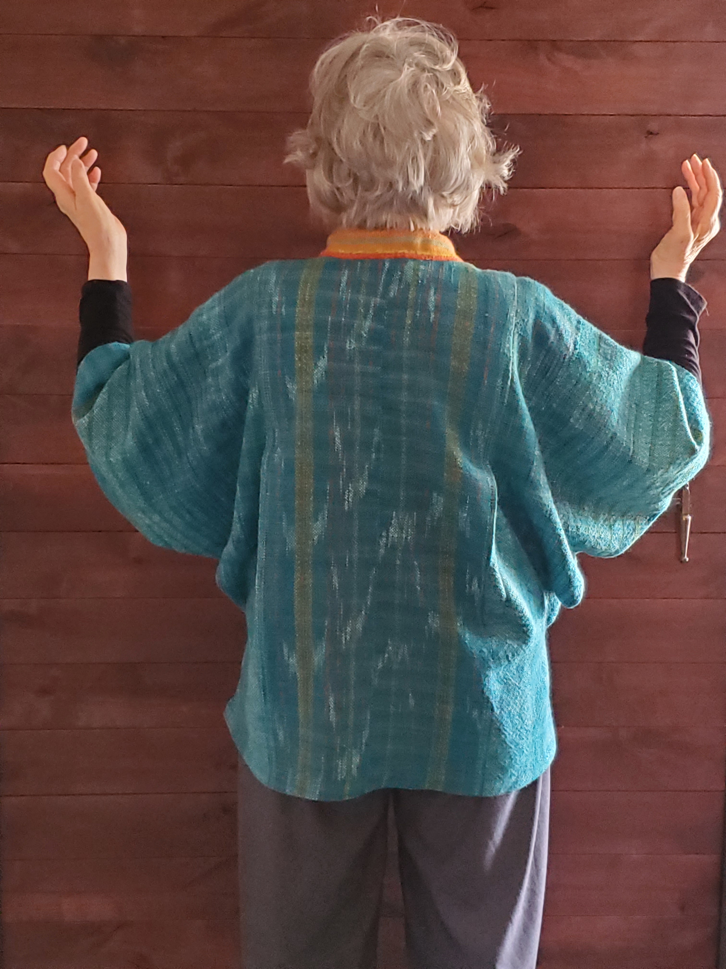
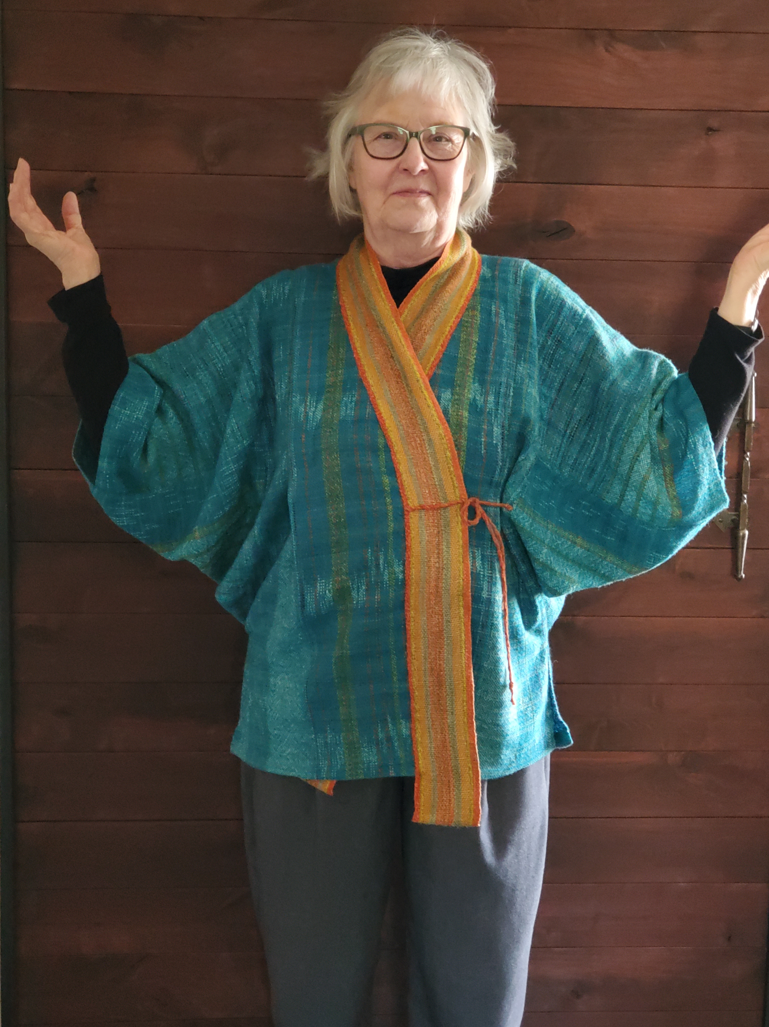
This kimono was made from a pattern in the Sara Lamb Weave to Wear book. It's made primarily from wool cone yarn and handspun silk. I learned seven new techniques in the making of this garment.

Slide 10
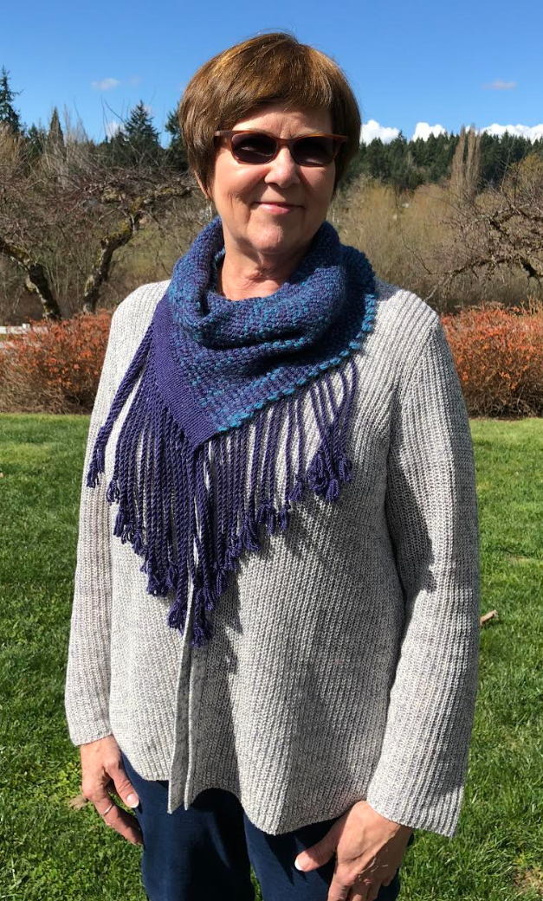
Raylene Keating: Fringed Cowl
Fabric:
Warp: Worsted weight Merino
Weft: Bulky weight Merino
8-dent heddle
Pattern:
Cat Bordhi

Slide 11
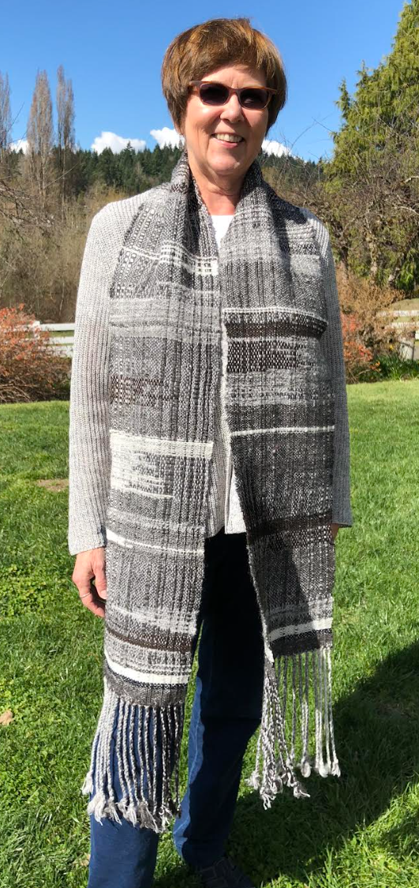
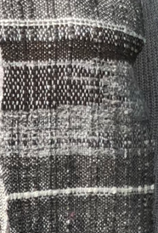
Raylene Keating: Saori scarf
Fabric:
Warp and Weft – My Handspun:
Grey Shetland
Blended greys
White Rambouillet blend
Brown Romeldale
Black Ribbon (sparsely used)
8 dent heddle
Pattern:
Saori Weave Inspired

Slide 12
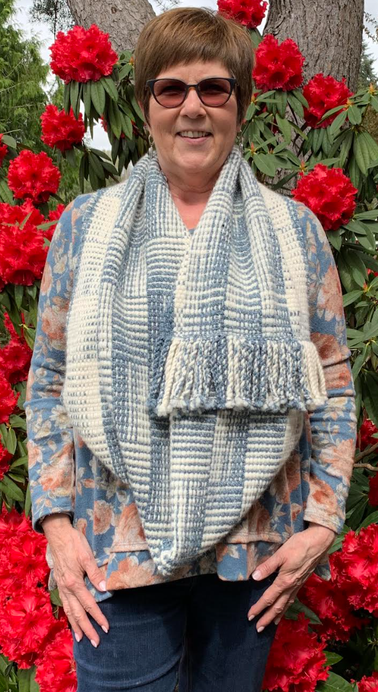

Raylene Keating: Log Cabin Mobius Scarf
Fabric:
Warp and Weft:
  White Merino Yarn – Purchased
  Handspun blue Merino blended with milkweed*
8 dent heddle
Pattern:
Log Cabin variation
* My 85+ Mother heard about spinning milkweed, so she went out and harvested milkweed pods from roadsides where she lived in Boise. Milkweed fluff isn’t strong enough to spin (fiber from the plant is) so I blended in the fluff to enjoy my Mom’s labor for years to come. She has since passed.

Slide 13
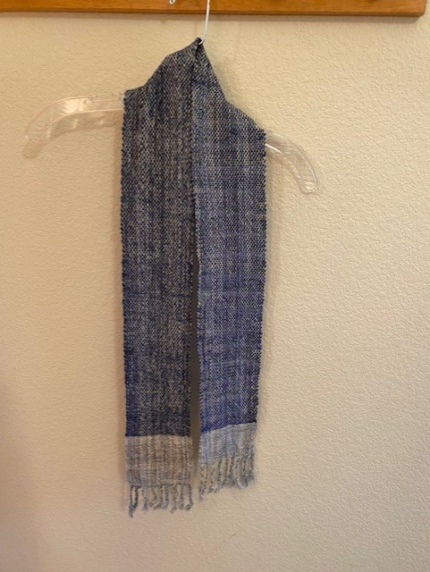
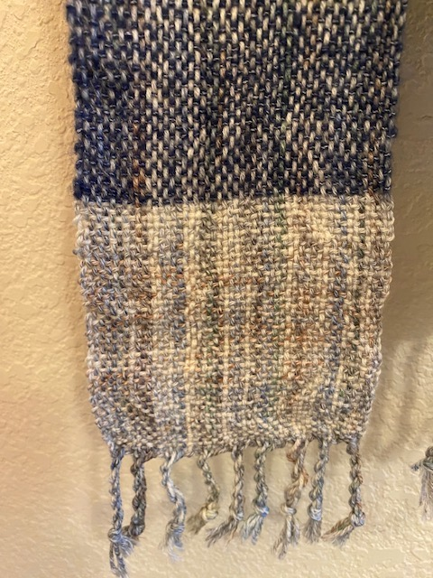
KAY PARKINSON: SCARF
This scarf was done on a rigid heddle loom by Kay Parkinson.
Width is 4 1/2” and length 63”
Warp: light, variegated wool yarn.
Weft: on either end a 2 1/2” band of the warp yarn and in-between 48” using a blue weft.

Slide 14
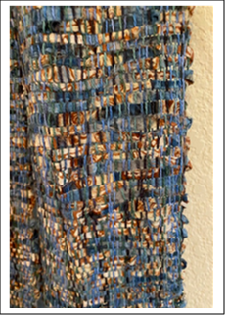
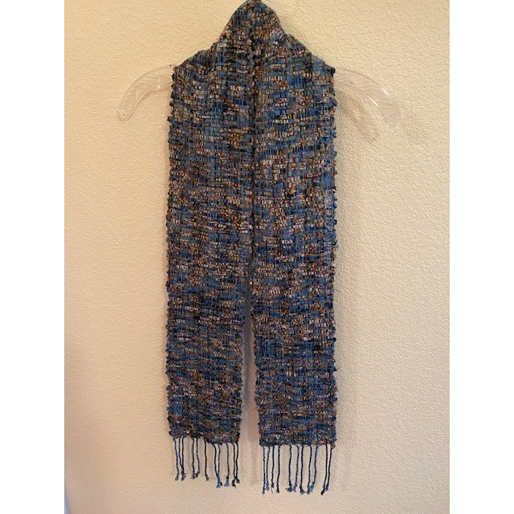
KAY PARKINSON: REPURPOSED SILK SHIRT SCARF
This scarf was woven on a medium blue cotton warp with a weft made of folded ½” strips of an old patterned silk shirt printed with blue, white and brown.
It is 7” wide and 63” long and was woven on a rigid heddle loom using a 10 dent heddle

Slide 15
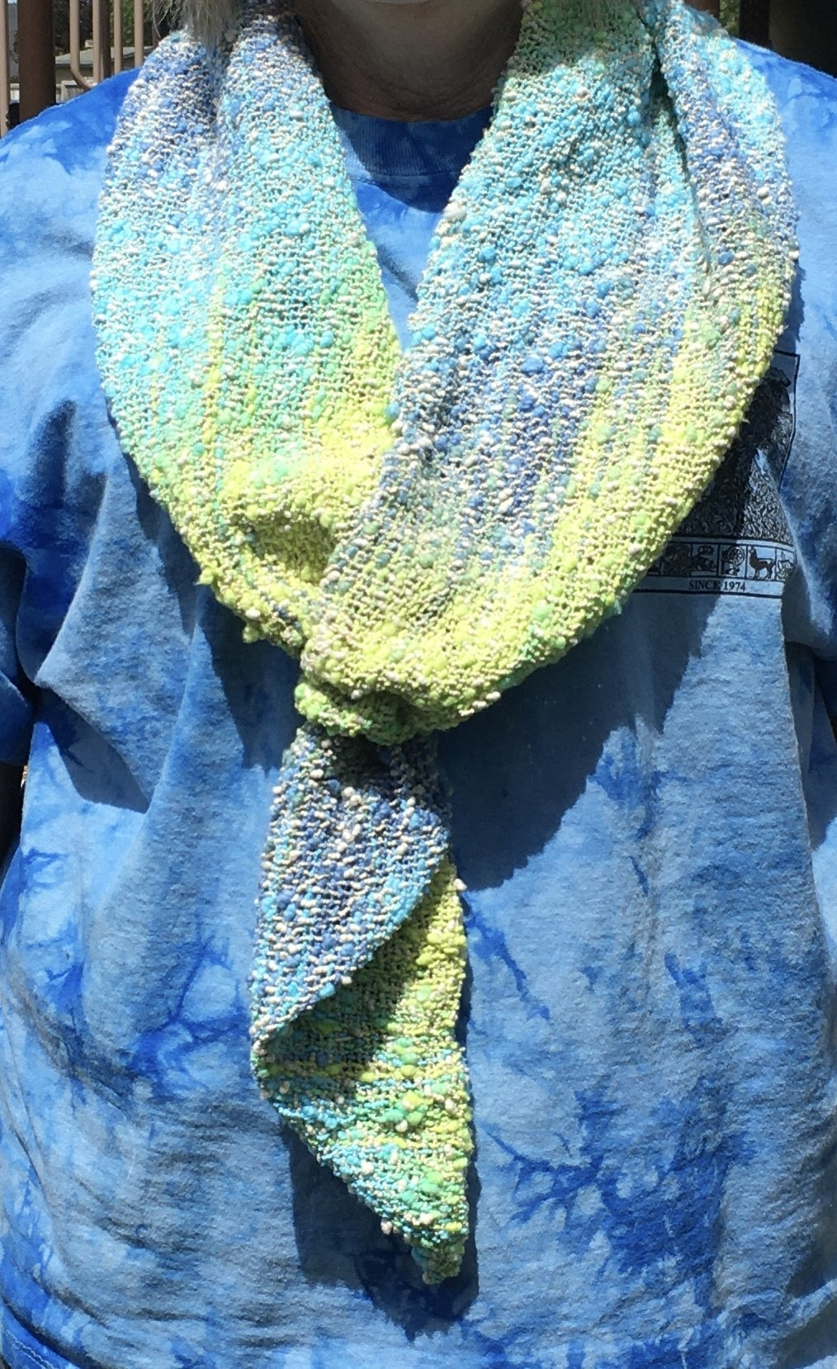
BETH O’MAHONEY - SCARF
This is a cotton scarf, woven on an Ashford rigid heddle loom
10 dent heddle
Hand-dyed warp.
Beth wound the warp threads on a warping board and then dyed them using a t-shirt tie dye kit.
Weft is an undyed textured cotton yarn.
Instead of fringe, she sewed one end into a triangle shape and the other end into a loop. The triangle end goes into the loop to hold the scarf in place.

Slide 16
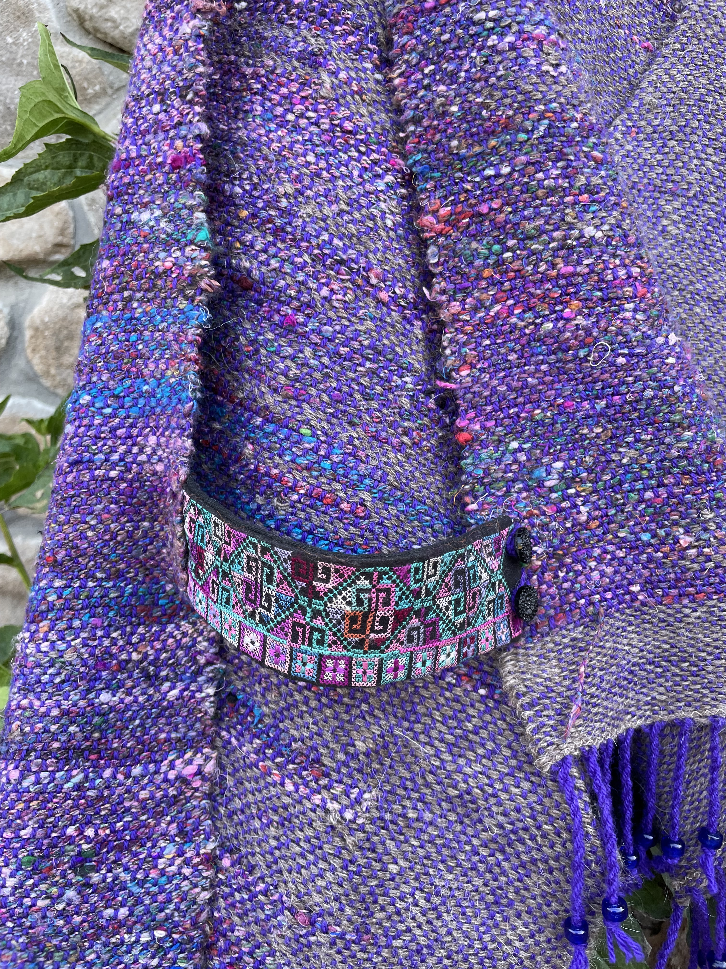
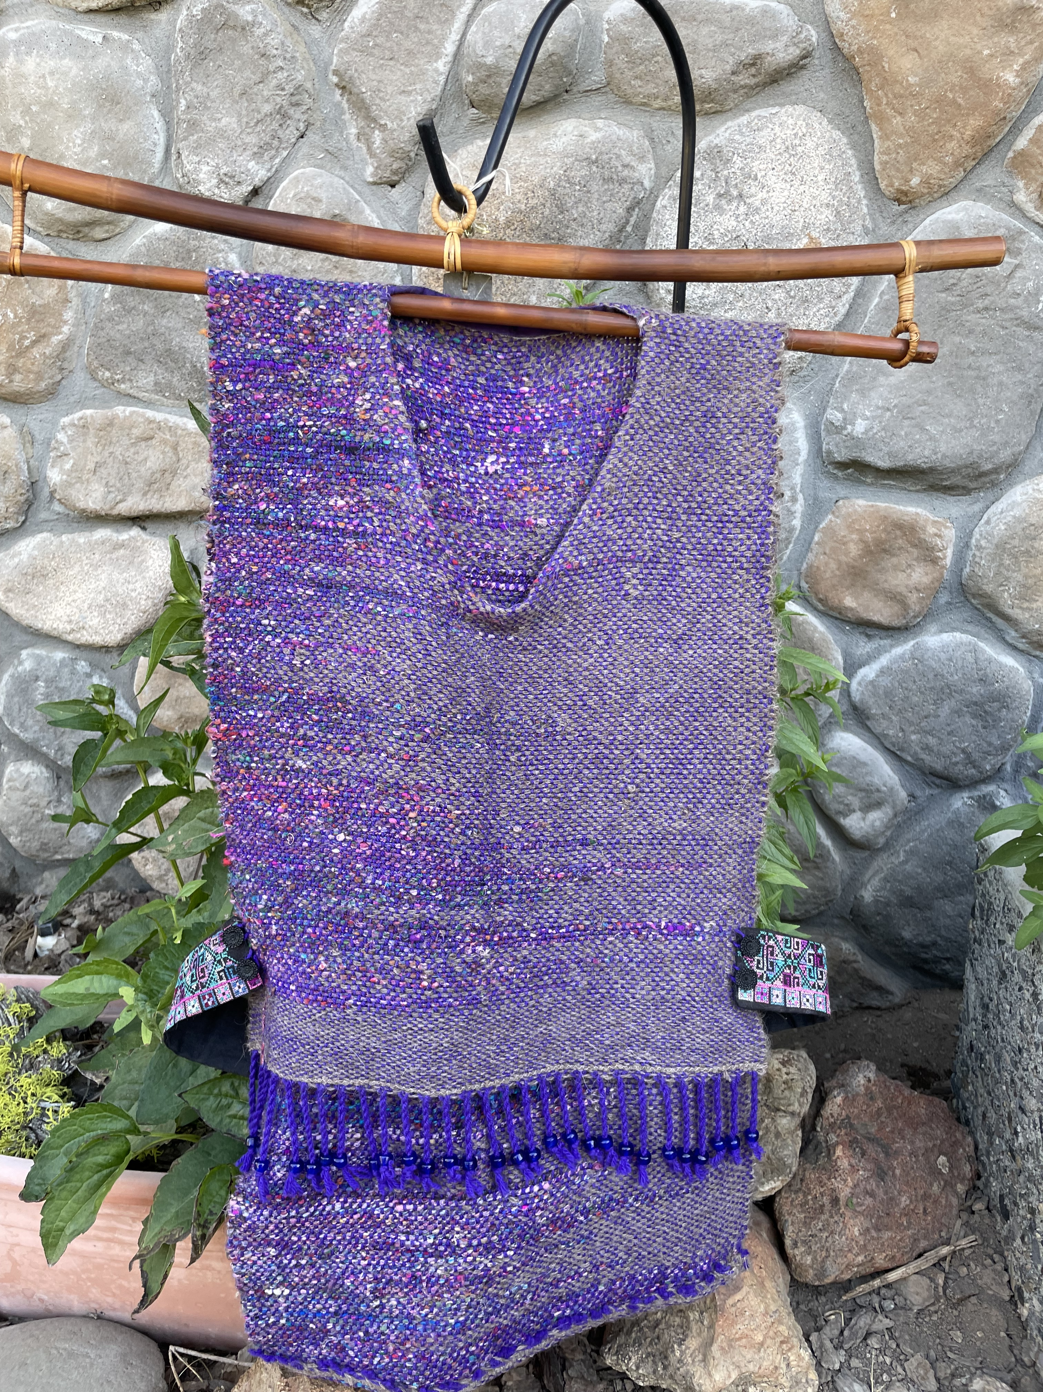
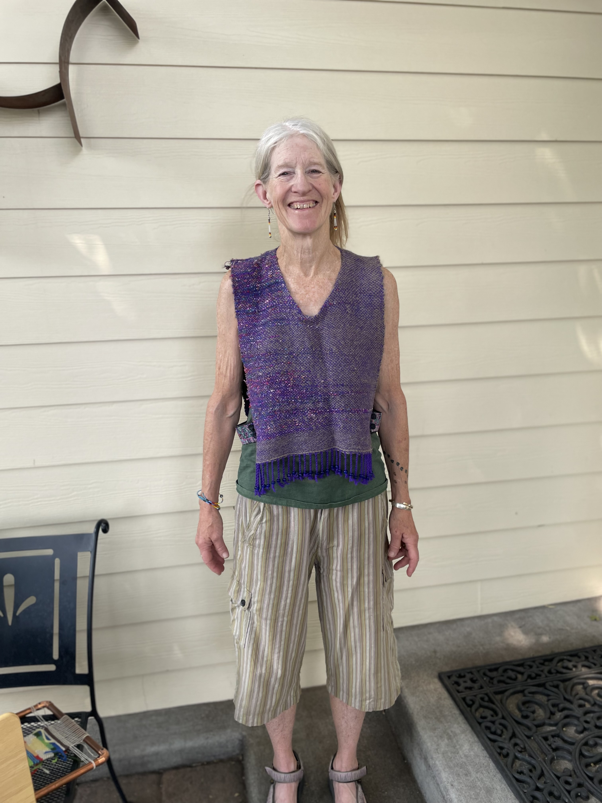
BARBARA KRACHER: TABARD
WANTING TO MAKE SOMETHING I COULD WEAR FOR WARMTH, I DECIDED ON A TABARD.
WEFT:
IN LOOKING THROUGH MY STORES OF FIBER, I DECIDED TO USE A LIGHT GREY, ALPACA YARN I PURCHASED FROM ONE OF THE BREEDERS IN THE BARN AT BLACK SHEEP GATHERING. I ALSO WANTED TO USE ONE OF THE TECHNIQUES WE LEARNED IN OUR STUDY GROUP. CLASPED WEFT FIT THE BILL, USING HANDSPUN SARI SILK!
WARP:
A BEAUTIFUL PURPLE CONE OF WOOL WAS BEGGING TO PAIR WITH THE LIGHT GREY AND LOVELY COLORS OF MY HAND-SPUN SARI SILK. BEING A MYSTERY CONE – I’M UNSURE OF THE TYPE OF WOOL.
8 DENT REED
I USED COBALT BLUE, GLASS BEADS ON THE FRINGE IN FRONT; NONE ON THE BACK AS I DIDN’T WANT TO LEAN OR SIT ON THEM!
THE SIDE TABS ARE FROM A BOX OF REMNANTS I RECEIVED FROM A FRIEND. THE REMNANTS ARE BEAUTIFUL PIECES OF WEAVING, EMBROIDERY. I’M DELIGHTED TO BE ABLE TO INCORPORATE THEM.
THE BUTTONS ON THE TABS ARE ANTIQUE FROM JARS I HAVE FROM MY MOM.

Slide 17
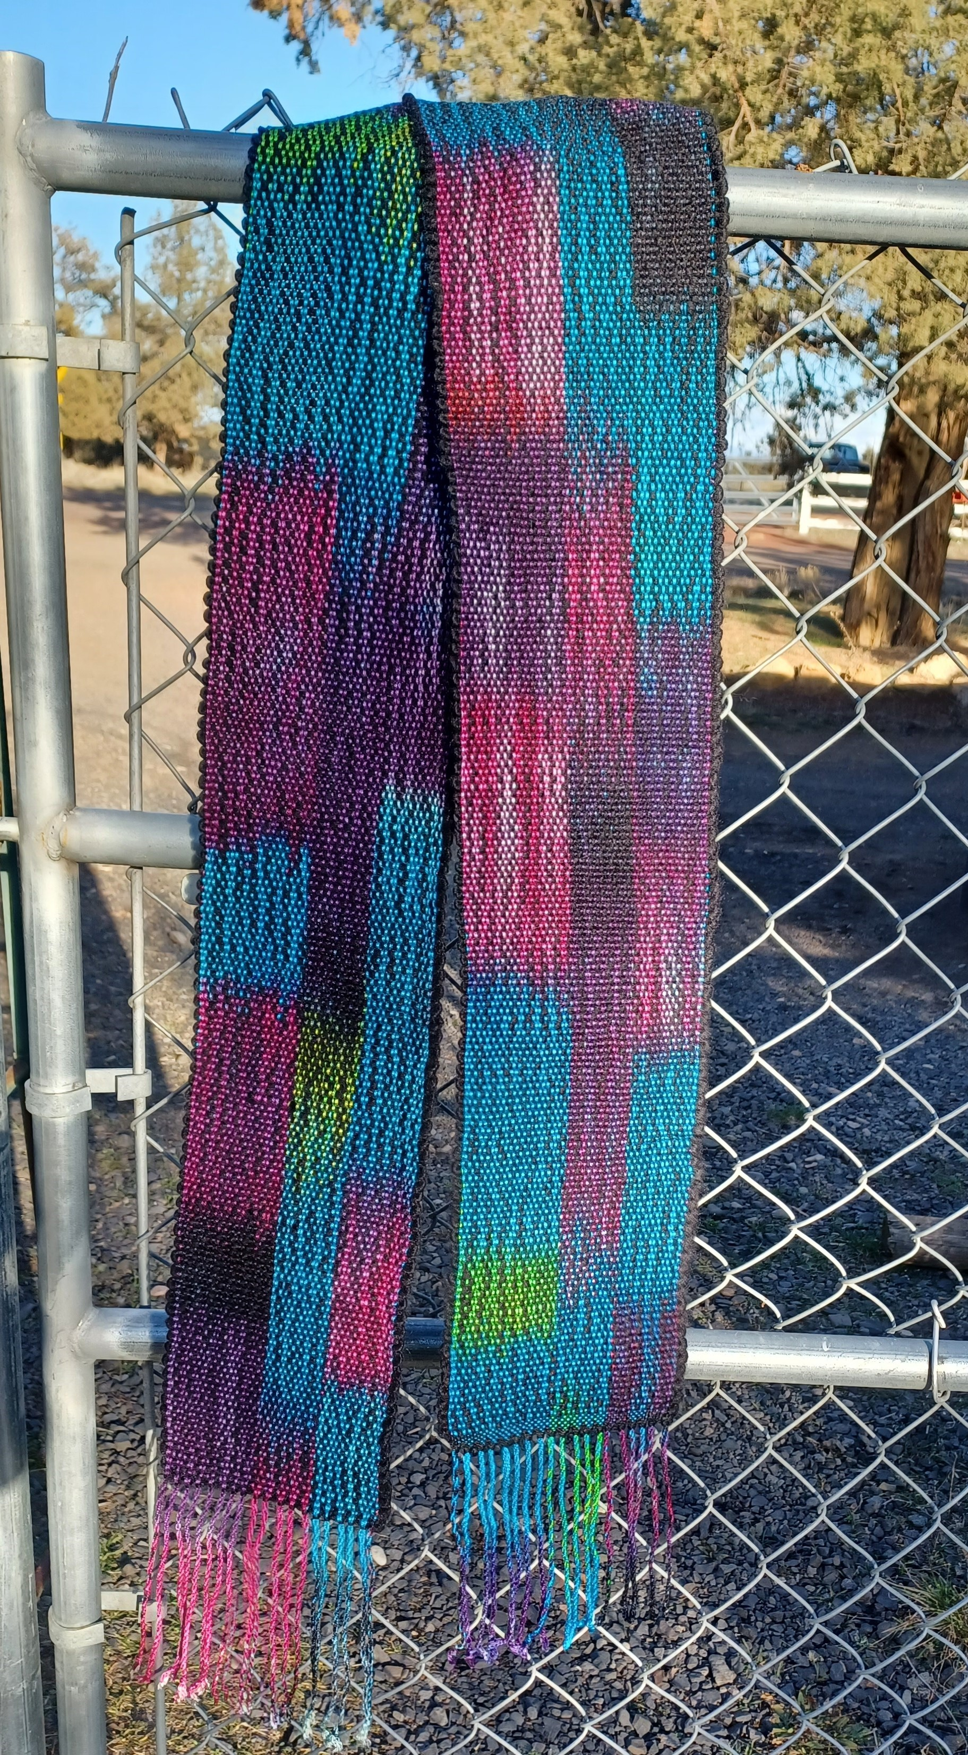
JAN ISBELL: SCARF
This is the scarf I wove on my 20 inch Schacht Flip Rigid Heddle Loom.
The scarf is 6 inches wide, woven on a 10 dent heddle.
Warp is Tencel and weft is wool/mohair.
Technique is plain weave using painted warp from a workshop.
I love the painted warp and had to experiment with the weft.
Ended up using a bulky weight wool/mohair blended yarn much heavier weight than the warp, but I achieved the effect I wanted.

Slide 18
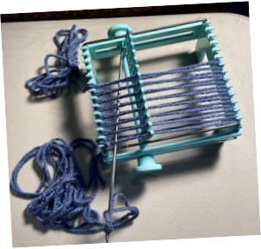

MARY ANNA SWINNERTON - EXPERIMENTAL
“ADD AND SUBTRACT“ VEST
ON A 4-INCH RIGID HEDDLE LOOM
Several months ago, looking through some of my small looms, I discovered a small loom for weaving
4” squares or 2”x 4” rectangles.

Slide 19
MARY ANNA SWINNERTON (CONT’D):
Looking at it more closely, I discovered that it was a rigid heddle loom with slots and holes that could be rotated to create sheds where weft, threaded on a 6” long needle, is passed through the shed. Moveable metal rods on the right and left sides made it easy to keep selvedges straight and one could also be moved to create a 2” x 4” rectangle.
This loom was made in 1964 by the Karbercraft Co. and called The Wonder Weave Hand Loom. I was intrigued with the idea of making squares and joining them to create a garment.
I started weaving squares and created seventy-five (75) 4” squares and twenty (20) 2”x 4” rectangular strips. Not being sure about how to join the pieces, I decided to do a single crochet around all four sides and then connect them to form a vest.
Finding some patterns using squares, I followed the suggestion of joining the squares in strips (for the appropriate length of the vest) and then sewing the strips together. Because each square had the crocheted edges, it created a rather bulky, but interesting vest that had a lot of depth, almost creating small “picture frames”.
Two (2) 2” wide by 19” long strips for the front opening were woven on my 10” Ashford rigid heddle Samplet loom.
GETTING THE RIGHT FIT: I decided on the length I wanted, took back and front measurements and hip measurements
to see how many squares were needed. This was when I decided to use a strip of 2”x 4” rectangles down the back under each arm and on either side of the front opening strip. It was nice to have that option. I used sewing thread to attach the individual pieces by hand.

Slide 20
MARY ANNA SWINNERTON (CONT’D):
I wanted the vest to hang straight and, in order to get that fit, I removed some of the squares and strips on the sides. This is why I call it the “Add and Subtract Vest”. If I lose some more pounds, I can add back some of the squares and have the vest filled in on the side. In the meantime, the front and back are held together with two (2) 4” squares and one (1) 2”x 4” strip under each armhole. To close the front, I found a Celtic Knot clasp in handmade antique brass from Etsy to attach to the tops of the front 2” wide strips.
MATERIALS AND PATTERN: Materials are 8 skeins of acrylic yarn, color Twilight Blue (Big Twist) from JoAnn Fabrics. The sett for the loom is 8 dpi and there are 24 rows woven for each square. A size 4 crochet hook was used for making the single crochet.
To add more color and interest, I decided to do some feather stitch embroidery in the narrow strips on the front and back and some French knots as accents. This was my first experience in doing much embroidery, so I keep learning. Another “Add” might be the addition of different embroidery stitches in some of the square “windows”.

Slide 21
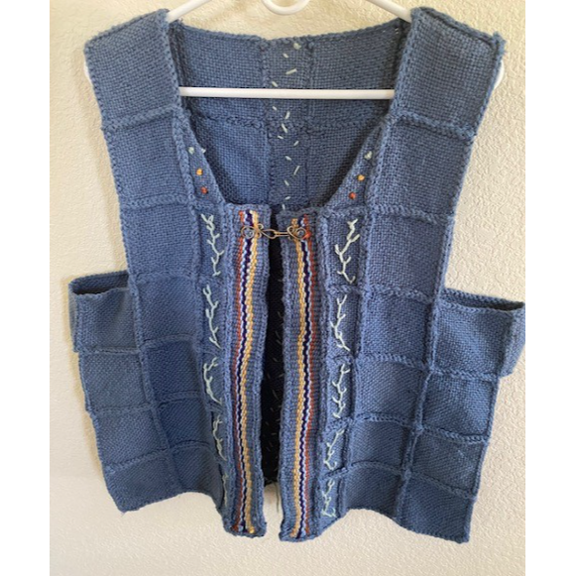
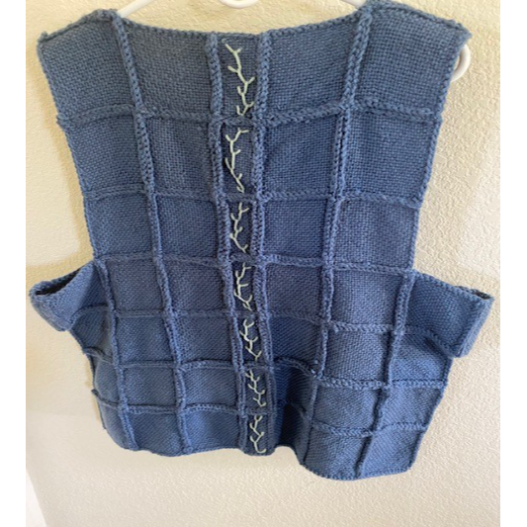
MARY ANNA SWINNERTON (CONT’D):

Slide 22
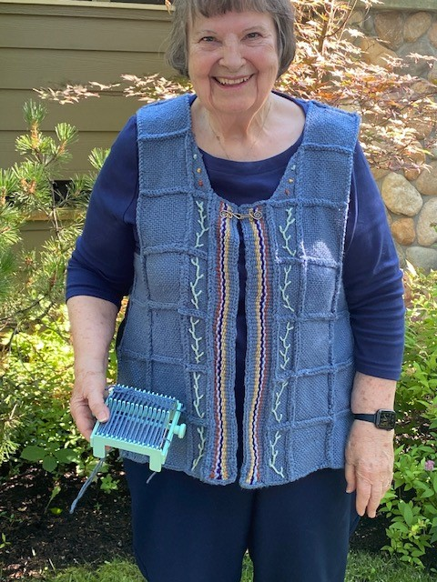
MARY ANNA SWINNERTON
(CONT’D)

Slide 23
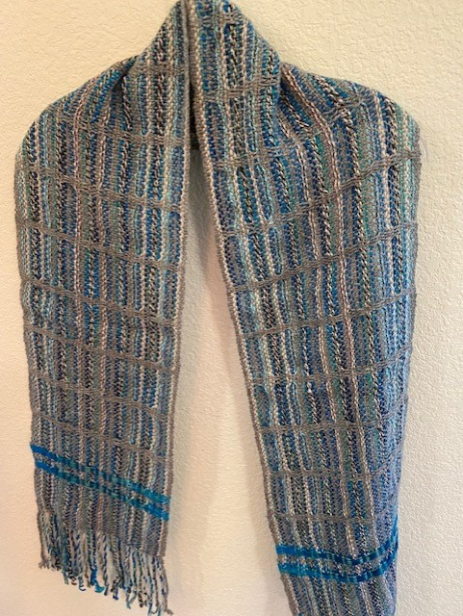
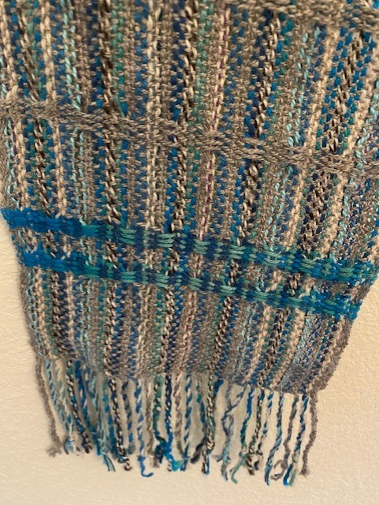
LINDA BUTTOLPH: SCARF
This scarf was woven using 100% alpaca
It measures
9” x 73”
100% alpaca was used for the warp and weft
15” wide Schacht flip rigid heddle loom was used
The horizontal accent strips were achieved by using pick- up sticks.

Slide 24
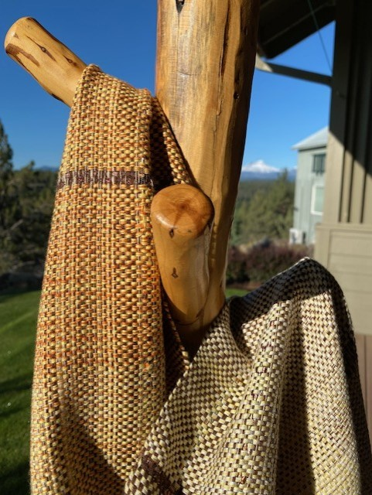
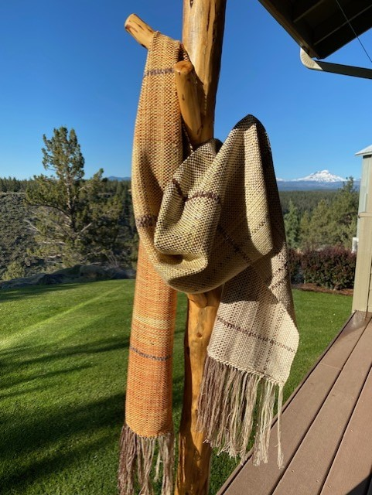
SHARYL McCULLOCH: SHAWL
68" x 11-1/2" + 5" fringes
Material:
(both warp and weft)
5 ply (!) cotton
dyed in gradient pattern – approx 1,100 yards
occasional sparkly ladder yarn.

Slide 25
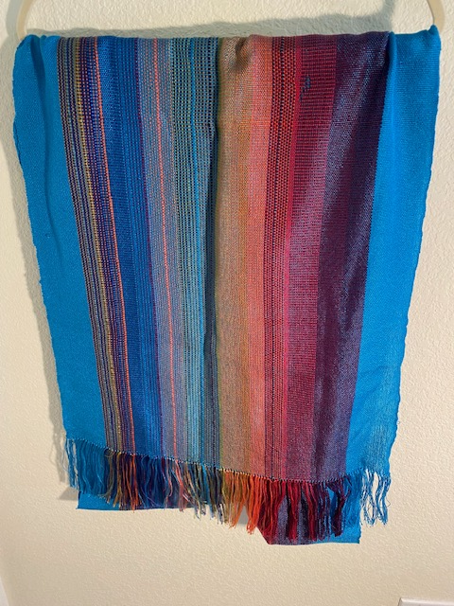
LYNN OWENS: HOROSCOPE SCARF
Lynn uses a 1 meter wide (39 inches) Chaneton rigid heddle loom (from Argentina, where she learned to weave).
Scarf is 22 2/3 inches wide.
Woven using a 12 dent heddle and 8/2 tencel yarns from Cotton Clouds
The colors chosen were from a Bonnie Tarses plan based on her horoscope on the day and time of her birth

Slide 26
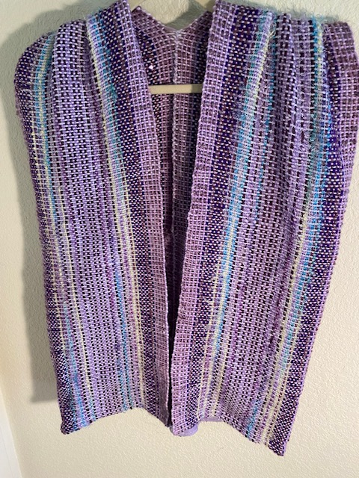
Lynn owens (Cont’d): STASH VEST
8 dent heddle
Vest is comprised of two 10” wide panels sewn together for the back.
Yarns: Novelty yarns from the “stash”.
Pattern: Plain weave with design by Debrah Jarchow in Handwoven – October 2012

Slide 27
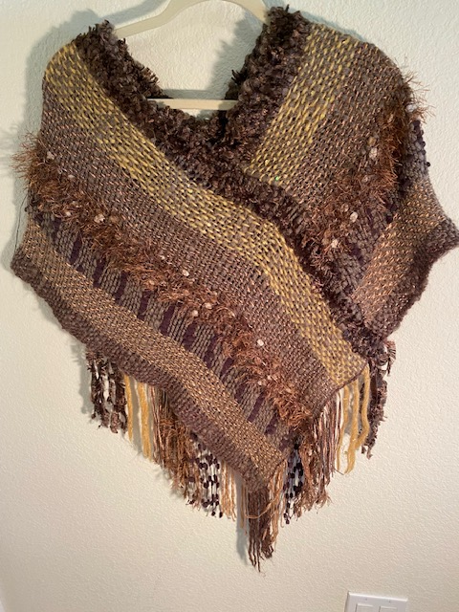
LYNN OWENS (CONT’D):
SHOULDER SHAWL
6 dent heddle
Novelty yarns woven in plain weave.
15” panels crossed in front and back

Slide 28
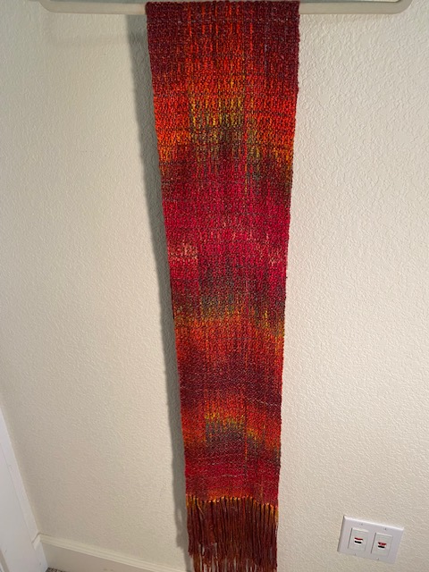
LYNN OWENS (CONT’D): HAND PAINTED BOUCLE SCARF
10 dent heddle
Hand-painted rayon boucle scarf
Yarn: Earth Guild Rayon Boucle

Slide 29
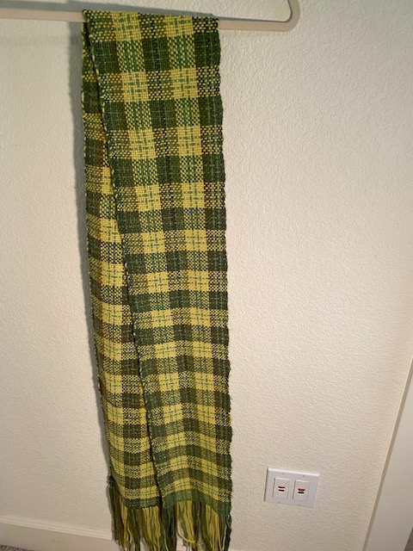
LYNN OWENS (CONT’D):
SCARF
10 dent heddle
Pick-up sticks in 5/1 lace
7” wide
Yarn: Green wool and novelty yarn
Pattern: Plaid

Slide 30
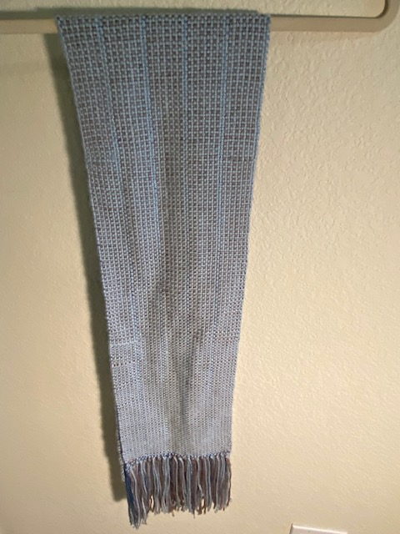
LYNN OWENS (CONT’D):
SCARF
8 dent heddle
Yarn: Blue and grey wool
Rayon
Pattern: Plain weave

Slide 31
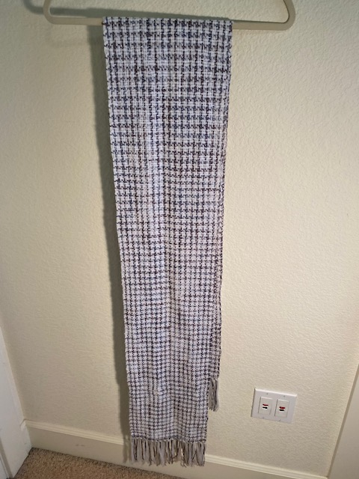
LYNN OWENS (CON’TD): SCARF
9” wide
Yarn: Baby rayon (x2) in dark grey and white
Pattern: Herringbone

Slide 32
THE END

