Slide 1
RIGID HEDDLE STUDY GROUP MEETING
AUGUST 22, 2023

Slide 2
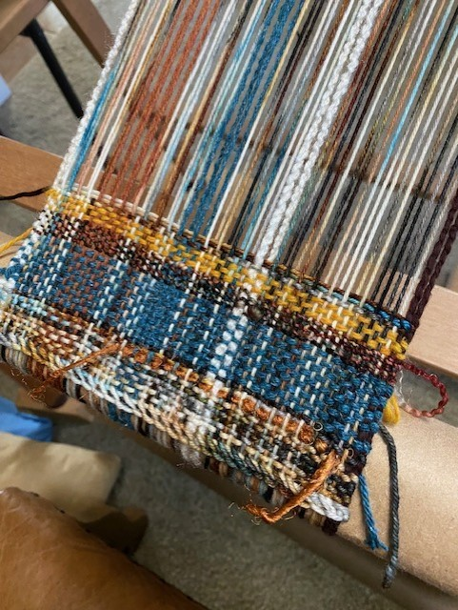
SHARYL McCULLOUGH: SCARF
Just started this scarf…..
I used supplemental weft inlay on the right side near the bottom. It's VERY fun!! - in fact, I'm calling it "Joyride" (!).
I know your "not supposed to" use knitting yarns for warp, but you know me - I often break the rules 😜
I do supplemental wefts a lot, love to design with them.

Slide 3
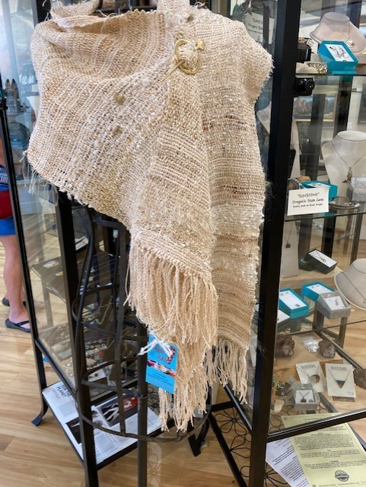
SHARYL McCULLOUGH: SHAWL
Another example of Sharyl’s pieces featuring supplemental warp

Slide 4
THE END

