Slide 1
RIGID HEDDLE STUDY GROUP
JUNE THROUGH AUGUST 2024

Slide 2
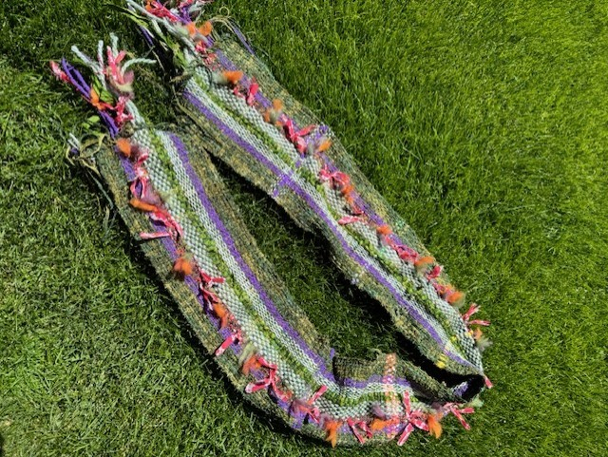
Sharyl mCculloch: scarf
"Farmers Market"
multi-fibers including cotton, art-yarn, merino, locks, ribbons, and merino.

Slide 3
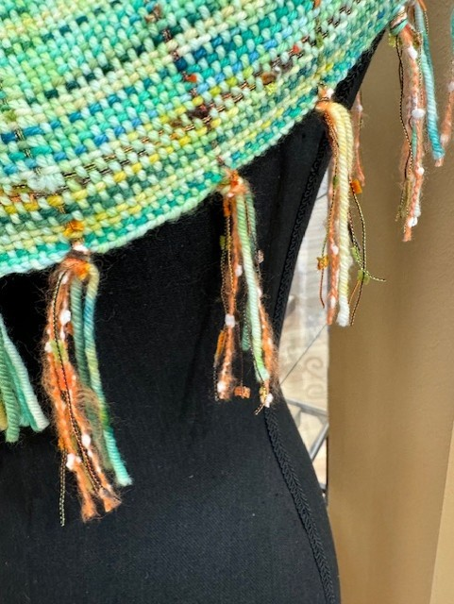
SHARYL MCCULLOCH (Cont’d): WRAP
“FRESH GREENS AND FRIENDS”
All hand-dyed merino except for the art yarn accents.
Two pics: the shawl displayed at Hood Avenue Art, and the second a close-up of the fringing

Slide 4
MARSHA PHELPS: TOP
22” x 74” saori style weaving
Warp = combo:
peach linen feza, handspun Koigu merino, hand painted cotton viscose, ribbon yarn
Weft = same yarns
10 dent reed

Slide 5
Raylene KEATING: SCARF
Warp Yarns - 76":
Handspun Polworth/silk "Thank Goodness its Not Chartreuse" (TGNC) roving , purchased at Ft. Gamble
LETTLOPI Iceland yarn for highlights -1406 Spring Green Heather color
Weft Yarns:
TGNC handspun
Sari silk strips - one strip added every 4"
Dent Size: 10
Fringe = Trimmed to 4" with Sari silk strips added
Finished Length after wet-finishing: 57" + fringe
Learnings:
The Polworth/silk handspun yarn is very stretchy (which is great), therefore, the length shrunk quite a bit after taking it off the loom and wet-finishing.
I will keep this in mind when warping similar yarns in the future to ensure I account for the amount of shrinkage
I would add weft floats next time for the rows with the sari silk

Slide 6
RANDEE FROMMER: shirt
I used a pattern from Judith Shangolds “Weave Knit Wear” to make this top.
Schacht Flip rigid heddle loom
12 DPI heddle
I used 3 colors of 8/2 rayon boucle, 4 ends of 20/2 rayon in the warp, and 4 ends of 20/2 rayon for the weft.

Slide 7
RANDEE FROMMER: (CONT’D ) creative weavings
These little “what-cha-ma-call-its” were made with antique Irish linen and a rigid heddle loom with a 12 DPI heddle.
They were formed wet over the rock egg that you see in one of them. I then brushed with diluted white school glue.
They are a sample test for a larger bowl to be made next.

Slide 8
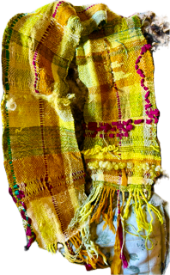
BARBARA KRACHER: SAORI PIECE
8 dpi
Glimakra Rigid Heddle Loom
Warp and weft combination of:
Handspun, natural dyed yarns (goldenrod, wolf lichen,
Dyed Blue-Faced Leicester locks
Recycled sari ribbon
8/4 cotton
Rayon chenille
Commercial wool fingering yarn, cotton fingering yarn, and rayon fine yarn from my stash.

Slide 9
KATHI KELLER: SAORI WOVEN WRAP
24” Ashford Rigid Heddle Loom
10 DPI heddle
Warp = variegated merino and alpaca
Weft = alpaca, slub cotton and ribbon

Slide 10
KATHI KELLER (Cont’d) : SAORI WOVEN scarf
24” Ashford Rigid Heddle Loom
10 DPI heddle
Warp = doubled variegated merino
Weft = merino, slub cotton and ribbon

Slide 11
THE END

